Slide 1
Types of Fats

Slide 2
View
What is Fat? Complete the Post Viewing Guide as you view. Go over correct answers.
https://www.youtube.com/watch?v=QhUrc4BnPgg

Slide 3
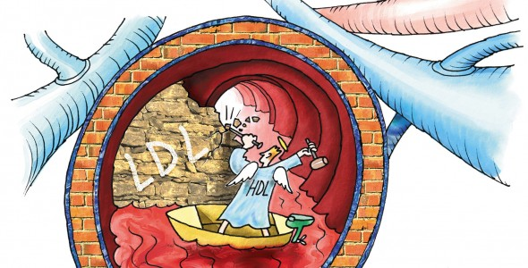
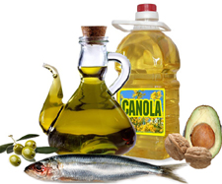
Unsaturated Fats: The Good
Come from plants
Liquid at room temperature.
Positive impact on health if eaten in moderation.
Increases HDL or good cholesterol levels and decreases LDL or bad cholesterol levels.

Slide 4
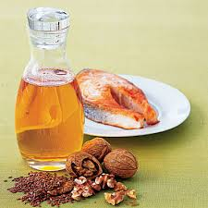
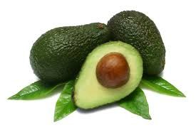
Unsaturated Continued
Two Main Kinds
Polyunsaturated: liquid at room temperature & when refrigerated (sunflower oil, corn oil, soybean oil). High in Omega 3 fatty acids such as avocados, nuts, salmon, herring and trout.

Slide 5
Unsaturated Continued
Monounsaturated: liquid at room temperature and begin to solidify when refrigerated. Examples include olive oil, canola, safflower, peanut and sesame

Slide 6
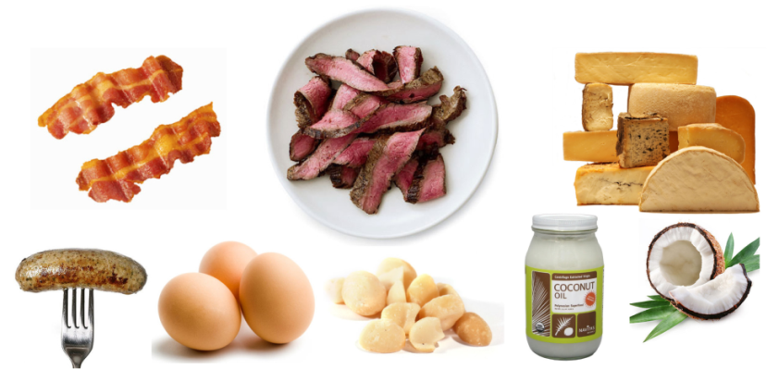
Saturated Fats: The Bad
Come from animal sources
Solid at room temperature.
Some plant sources are good fats like palm & coconut oil
Examples include various fatty meats, butter, cheese, eggs, dairy products.

Slide 7
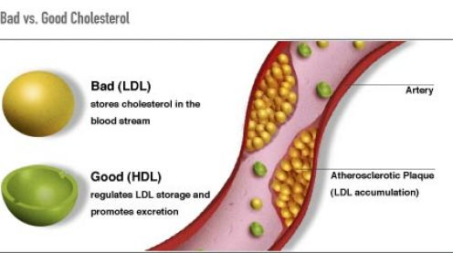
Saturated Fats Continued
Negative impact on the diet because most American’s get too much
The body can actually produce what is needed
Increases bad cholesterol or LDL levels.

Slide 8
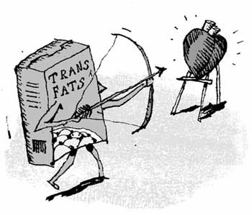
Trans-fats: The Ugly
Man-made fat produced by pumping hydrogen into vegetable oil
Can 100% be eliminated from the diet with no adverse effects
Has double the negative impact on the heart compared to other fats

Slide 9
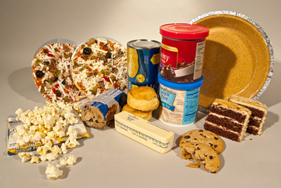
Trans-fats Continued
Causes high cholesterol and heart disease issues. Increasing LDL or bad cholesterol levels and decreases HDL or good cholesterol levels.
Found in cakes, pies, cookies, candies, fried and battered foods, fast foods, margarines, shortening, canned frosting, crackers and Slim Jims

Slide 10
Summary/Review
https://www.youtube.com/watch?v=3Gqo3Y6WFYA
Complete the Classify the Fats activity with crayons or markers and place in the basket for grading when finished

