Slide 2
Guesstimate the cost of each item!

Slide 3
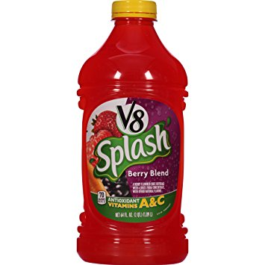
V-8 Splash 64 oz.

Slide 4
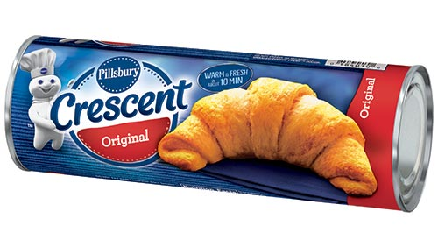
Pillsbury Crescent Rolls--10 count

Slide 5
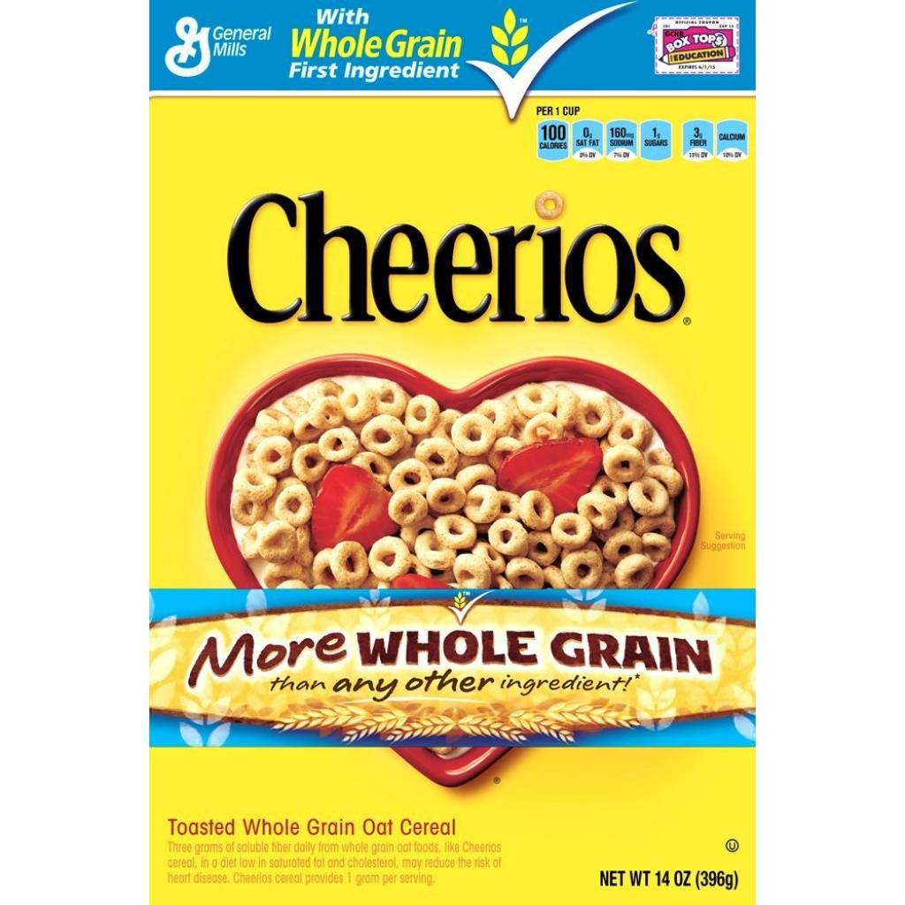
General Mills Cheerios 14 oz.

Slide 6
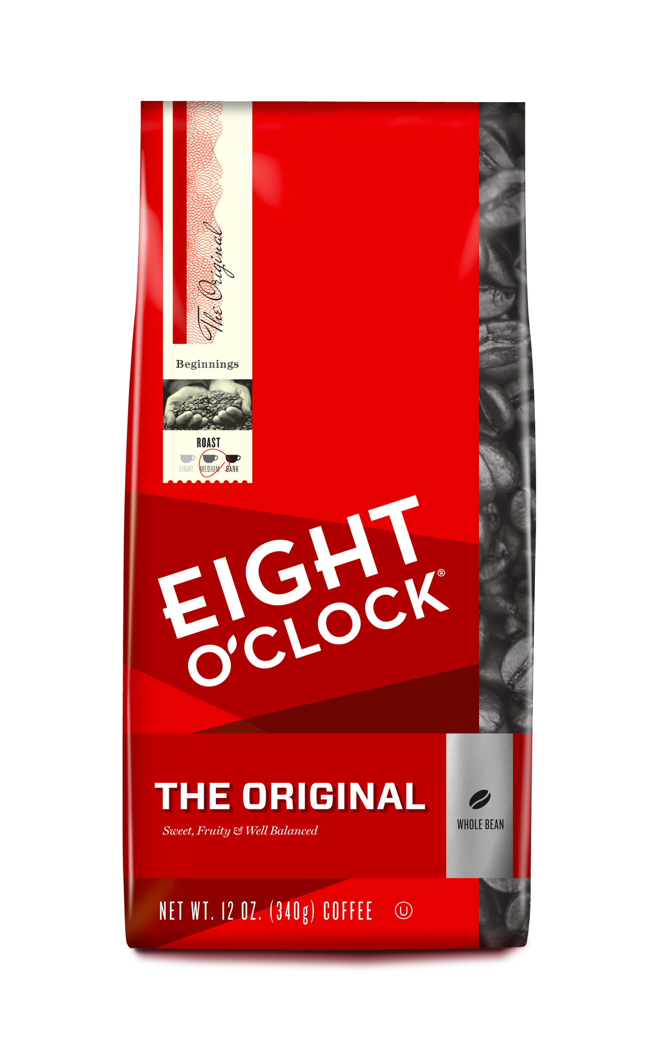
Eight O’Clock Coffee 11 oz.

Slide 7
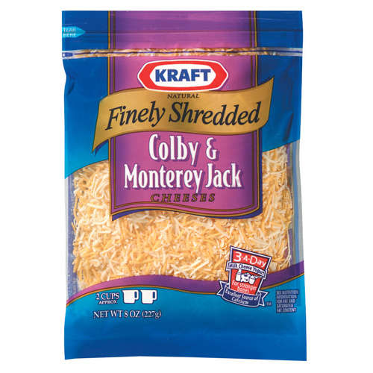
Kraft Shredded Cheese 8 oz.

Slide 8
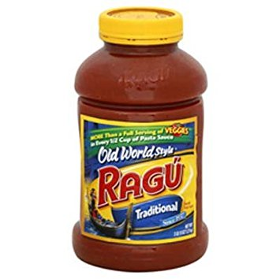
Ragu Spaghetti Sauce 45 oz.

Slide 9
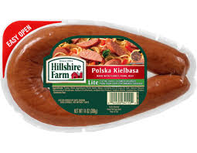
Hillshire Farm Lite Kielbasa 14 oz.

Slide 10
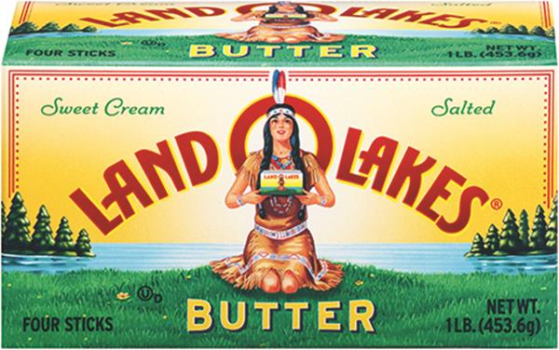
Land O Lakes Butter 1 lb.

Slide 11
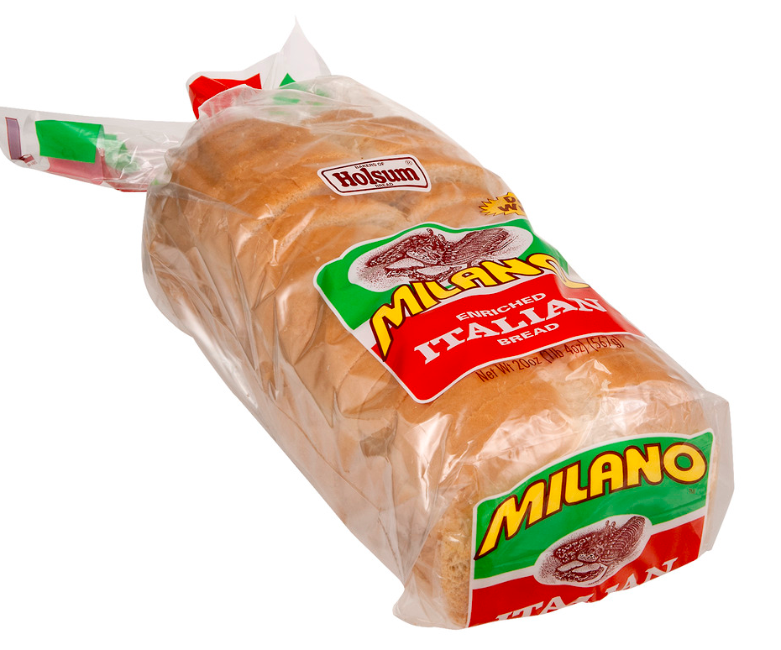
Milano Italian Bread 22 oz. Loaf

Slide 12
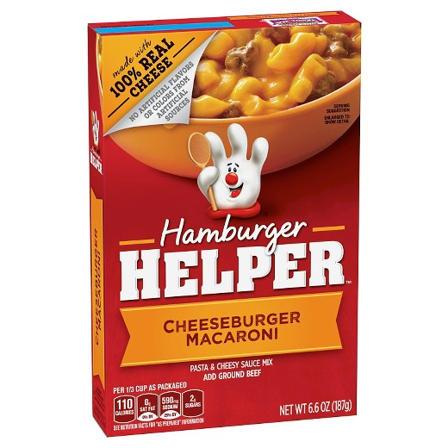
Hamburger Helper 7.5 oz.

Slide 13
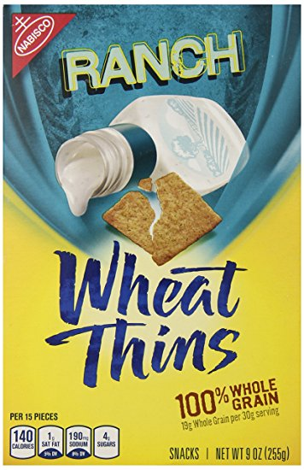
Nabisco Wheat Thins 8 oz

Slide 14
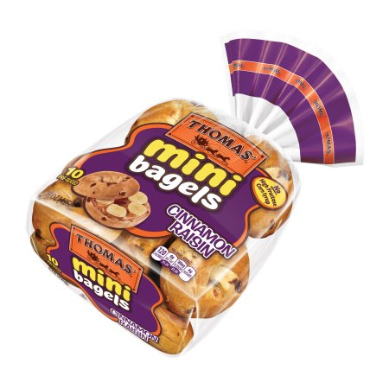
Thomas’ Mini Bagels--12 count

Slide 15
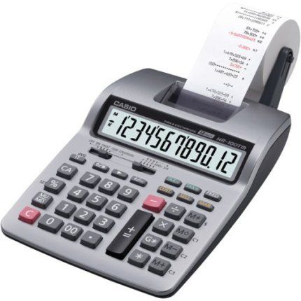
GRAND TOTAL
Add up the prices you estimated for each product for a GRAND total!

Slide 16
SHARE Totals Spent

Slide 17
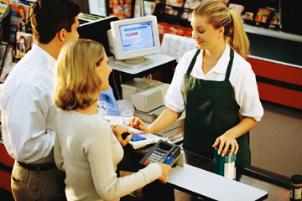
REAL Prices

Slide 18
V-8 Splash 64 oz. $2.59

Slide 19
Pillsbury Crescent Rolls--10 count $2.49

Slide 20
General Mills Cheerios 14 oz. $3.59

Slide 21
Eight O’Clock Coffee 11 oz. $6.19

Slide 22
Kraft Shredded Cheese 8 oz. $3.99

Slide 23
Ragu Spaghetti Sauce 45 oz. $2.99

Slide 24
Hillshire Farm Lite Kielbasa 14 oz. $4.49

Slide 25
Land O Lakes Butter 1 lb. $3.99

Slide 26
Milano Italian Bread 22 oz. Loaf $2.99

Slide 27
Hamburger Helper 7.5 oz. $1.79

Slide 28
Nabisco Wheat Thins 8 oz $3.69

Slide 29
Thomas’ Mini Bagels--12 count $4.69

Slide 30
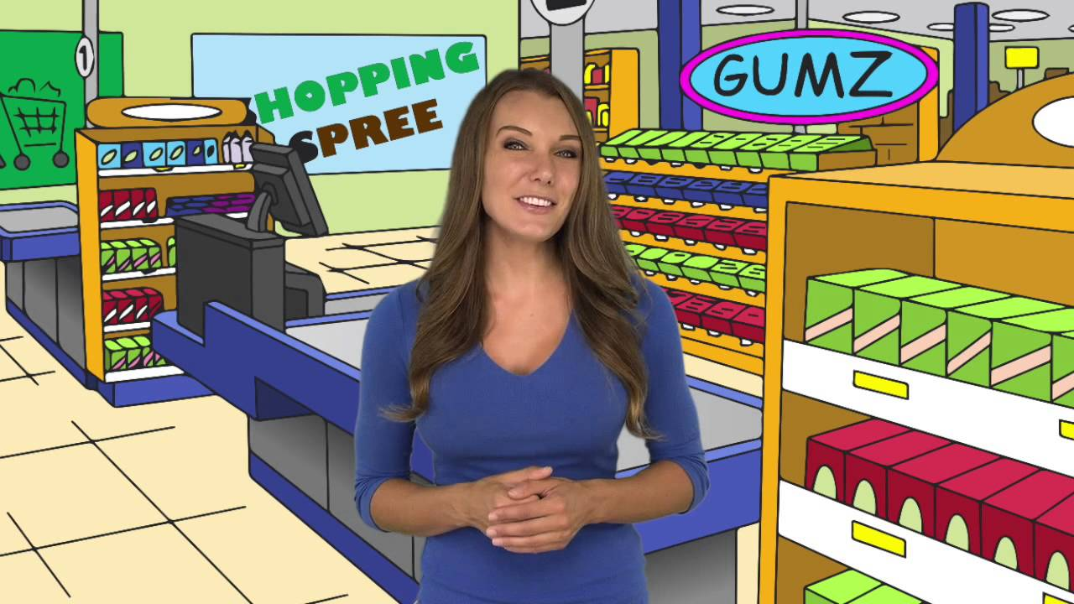
GRAND TOTAL
$43.48

Slide 31
Closest Guesstimate Winner?
Calculate the difference between your guesstimate total and the actual total to see who is the winner of “The Price is Right”!

