Slide 1
Mindfulness
Singlehood & Selfcare

Slide 2
Mind Full or Mindful?
Moving your body, doing your job, loving your family, playing a game, preparing a meal, everything that you do…
requires your mind to engage, plan, direct.
Notes:
Image Credit: https://www.uhs.umich.edu/files/uhs/field/image/Mindfulness.jpg
Daily Do Now: When you brush your teeth in the morning, what do you think about?

Slide 3
What is Mindfulness?

Slide 4
Mindfulness is the practice of paying attention to what’s happening in our lives in a particular kind of way: on purpose, in the present moment, and with curiosity, openness and kindness.
A calm, focused, and strong mind improves nearly every aspect of your life, so taking care of your mind is truly an act of generosity towards yourself.

Slide 5
Activity: Mindful Breathing
Notes:
https://healthypsych.com/5-minute-mindful-breathing-exercise/

Slide 6
Why Mindfulness?

Slide 7
Scientific studies show that mindfulness:
boosts your immune system
increases + emotions
decreases depression & anxiety
grows additional gray matter in your brain
improves focus
fosters compassion
enhances relationships

Slide 8
Practicing Mindfulness

Slide 9
Activity: Mindful Listening
Notes:
Discussion: Pose the questions: what were you thinking about? What did noises did you hear? Have students think, pair up & share -or- use it as a journal entry.
Further discussion: Most of the time you are surrounded by a whole range of environmental noises and most of them barely register in your awareness.Much like the noise inside your mind, external noises often go unnoticed. The noise in your mind and the noises in the world around you both form an invisible backdrop to your entire life.
Ask students:When was the last time you REALLY listened to the sounds that are taking place around you?
After the second exercise, what did you hear? How was this exercise different than the first time? Students should be able to list many more sounds if they completed the exercise by listening intently.

Slide 10
Mindfulness is simple, really. It’s just noticing each thought, feeling, body sensation, and surrounding environment in the moment as you’re experiencing it without judging it as good or bad.
Every moment and experience gives you an opportunity to practice mindfulness and improve the quality of your mind.
Notes:
https://www.uhs.umich.edu/files/uhs/field/image/Mindfulness.jpg

Slide 11
Mindful Meditation
Andy Puddicombe, a former Buddhist monk, describes meditation as “about stepping back, seeing the thought clearly — witnessing it coming and going — without judgment, but with a relaxed, focus mind.”
What does that sound like?

Slide 12
Activity: Mindful Eating
Notes:
https://www.jmu.edu/counselingctr/files/Mindful%20eating.pdf
Hershey Kiss for every student

Slide 13
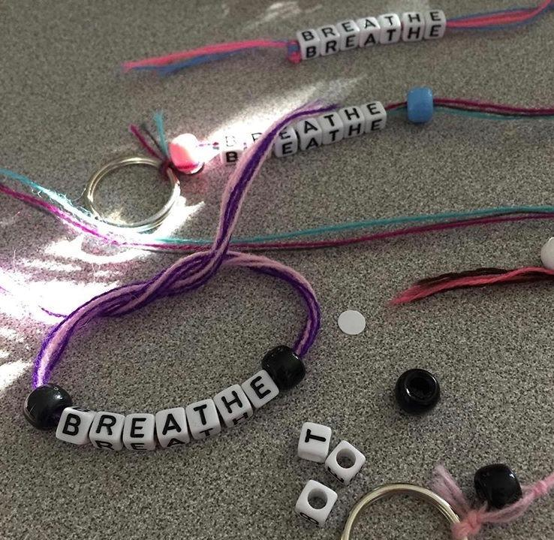
Activity: Bead Breathing
Bracelet -or- Keychain
Choose your…
Embroidery Floss Colors
Max 3
7 colored beads -or- 2 colored beads & 7 letters
Notes:
The purpose of bead breathing is to provide students with a hands-on approach to take a set number of controlled, deep breaths.

Slide 14
Credits
Broderick, P. C. (2013). Learning to breathe: a mindfulness curriculum for adolescents to cultivate emotion regulation, attention, and performance. Oakland, CA: New Harbinger Publ.
Lipinski, S. (2015). 7 Generosity Habits [Ebook]. www.changegangs.com.
Why Mindfulness is a Superpower: An Animation.(2015, December 07). Retrieved July 07, 2017, from https://www.youtube.com/watch?v=w6T02g5hnT4
Meditation 101: A Beginner’s Guide Animation. (2015, June 24). Retrieved July 07, 2017, from https://www.youtube.com/watch?v=rqoxYKtEWEc
Presentation template by SlidesCarnival

