Slide 1
Breakout

Slide 2
Bell Ringer
What do the letters FBI stand for?

Slide 3
Did you know?...

Slide 4
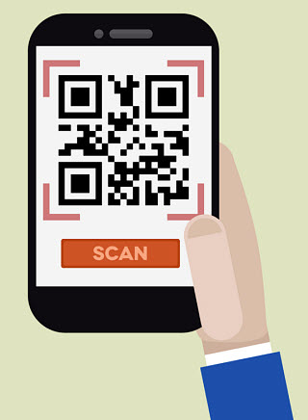
Food Safety Breakout
Put puzzles together correctly to learn more about the actions you can take to reduce your risk or prevent FBI’s. Write this info on your notes form
Scan the QR Codes for the #’s
to open the box
(think alphabetically)

Slide 5
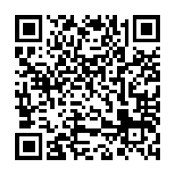
Food Safety Action
Icon
Suggested Tips:
-Refrigerate foods within 2 hours.
-Safely thaw food in the refrigerator, microwave or in cold water;never on the counter.
-Be sure to use ice packs if traveling.
Why it Matters:
Bacteria can multiply in perishable foods within 2 hours so refrigerate promptly.
Notes:
Cut apart into 4 quadrants.

Slide 6
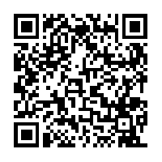
Food Safety Action
Icon
Why it Matters:
Bacteria can lurk in your kitchen and can be found on your hands, utensils and cutting boards.
Suggested Tips:
-Wash your hands for 20 seconds with warm water and soap.
-Wash dishes, utensils & cutting boards with hot, soapy water after each use.
-Wash/Rinse produce to remove bacteria, dirt and pesticides before consuming.
Notes:
Cut apart into 4 quadrants.

Slide 7
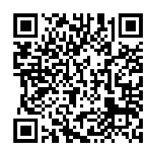
Food Safety Action
Icon
Why it Matters:
Bacteria multiplies the quickest when it’s in the DANGER ZONE. Danger zone temperature range is between 40˚ and 140˚ F.
Suggested Tips:
-Use a meat thermometer to ensure that foods are cooked/ heated to proper temperatures. -Don’t rely on color and texture to indicate doneness.
Notes:
Cut apart into 4 quadrants

Slide 8
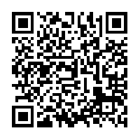
Food Safety Action
Icon
Why it Matters:
-Raw meat, poultry, seafood, and eggs can spread illness-causing bacteria to ready-to-eat foods—unless you keep them separate.
Suggested Tips:
-Keep raw meat/poultry apart from ready-to-eat foods at home, at the store and in the refrigerator.
-Use different cutting boards, plates & utensils when preparing raw & ready to eat foods.
-Place meats that might drip/leak on the lower shelves in the refreigerator.
Notes:
Cut apart into 4 quadrants and mix together with the other cut up quadrants, adding to the manila envelopes. You will need one complete set/envelope per group.

Slide 9
Four Steps to Food Safety
___Food Safety Action:________________________ Sketch the Icon: Why it Matters: Suggested Tips: | __Food Safety Action:__________________________ Sketch the Icon: Why it Matters: Suggested Tips:
__Food Safety Action:_________________________ Sketch the Icon: Why it Matters: Suggested Tips: | __Food Safety Action:__________________________ Sketch the Icon: Why it Matters: Suggested Tips:
Notes:
Copy one for each student.

Slide 10
Directions
Set 4 Digit Locks to:
Chill - 5
Clean – 6 Complete notes form with this information.
Cook – 8
Separate – 3
The clue for the right combo is – ALPHA Order (if students put the terms in alphabetical order correctly, it will unlock the lock)
Cut the Frayer diagrams into 4 sections and scramble.
Copy the Food Safety Actions Scenarios WS and place into a small breakout box and lock with the 4 digit combination lock (include a few pieces of candy in the box as a prize for breaking out).
Students may eat their candy while they work through the “Food Safety Actions Scenarios” . Students may refer to their notes as they complete this assignment. Once students finish, they place their completed work in the basket to be graded!
Notes:
Teacher Notes for Boxes/Combinations.

