Slide 1
Periodic Table of Fruits and Vegetables

Slide 2
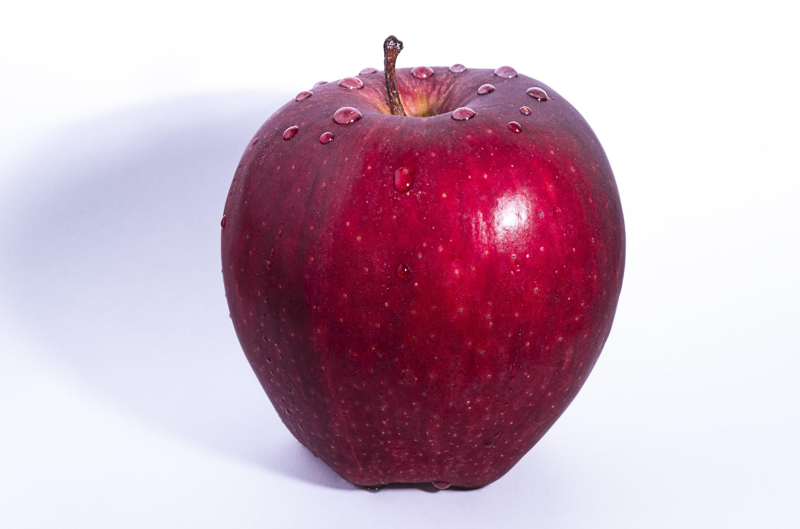
Calories/Serving
95
Serving Size
1 medium apple
Ap
Where is this grown or grown best:
Most apples are grown in China (35%), US comes in second 7.5%. Apples start in the spring and continue to grow until the fall.
How to prepare or use:
Eat fresh but remember to rinse off. Great baked in pies,muffins, cakes and bars. May also use in fresh fruit salads. Apples can also be frozen or canned as in applesauce and juiced to make apple cider.
Health benefits:
Apples help maintain the health of a digestive system. Helps support strong bones and healthy brains. Apples have vitamin C, which boosts
immunity. Apples act as a toothbrush cleansing the mouth and killing bacteria. Apples are low in calories.
When and from where did this come to the United States: European settlers of the Americas brought with them in the 1500’s. It was much favored over the native crab apple. It originally was grown in Asia as early as 2000 BC.
Vital Nutrient % DV:
Vitamin A 1 %
Vitamin C 10%
Vitamin K 3%
Calcium 1%
Iron 1 %
Potassium 4 %
Dietary Fibers 12%
Information by: Mrs. Odle, 1st period

Slide 3
Calories/Serving
Delete and write down the calories per serving for this food
Serving Size
Delete and write down the serving size
Sy
Where and when is this grown best:
2-3 facts in paragraph form including country that grows the most, what season it is grown during.
How to prepare or use:
2-3 facts in paragraph form including how can you prepare and use your fruit/vegetable (frozen, fresh, dried, juiced, baked, etc)
Health benefits:
2-3 facts in paragraph form these will probably be similar to what you include in your vital nutrients list plus other facts.
If you need extra space for your health benefit info it can be split and part can go here.
When and from where did this come to the United States: 2-3 facts in paragraph form including where your fruit/vegetable was originally grown (again what country) and when was it brought to the United States.
Vital Nutrient % DV:
5-7 major vitamins or minerals found in your fruit or vegetable. If you search nutrition facts on your fruit you will find the list.
Delete and add your own picture
Information by: Student Name and Period

