Slide 1
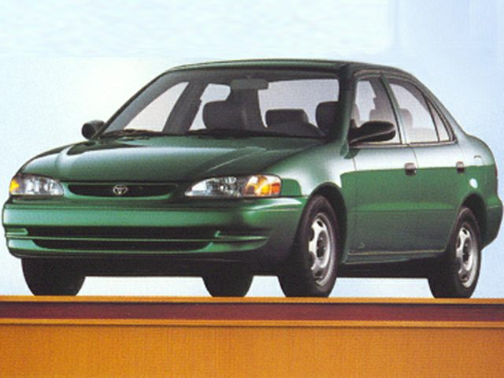
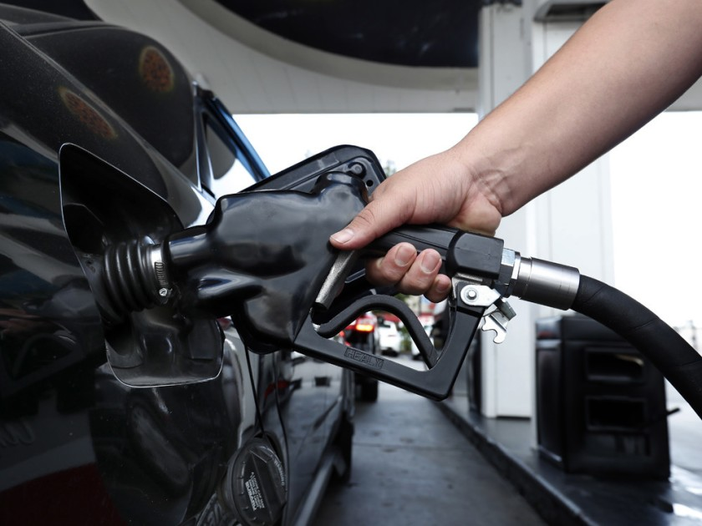
Basket of Goods: 1999 Cost?
Notes:
Car ($20,686)
Gallon of Gas ($1.17)
Movie Ticket ($5.08)
Postage Stamp ($.33)
Grand Total ($20,692.58)

Slide 2
Basket of Goods: 2019 Cost?
Notes:
Car ($36,718)
Gallon of Gas ($2.59)
Movie Ticket ($9.26)
Postage Stamp ($.55)
Grand Total ($36, 730.40)

