Slide 1
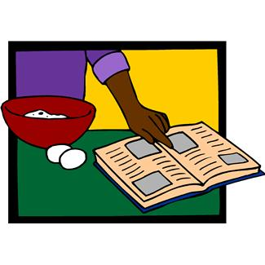
Adjusting Recipes
Sometimes recipes are created in the right amount for the number of people you are serving.
Sometimes recipes don’t make enough for the number of people you are serving so you must increase your amounts.
Sometimes recipes make too much for the number of people you are serving so you must decrease your amounts.

Slide 2
Increasing Amounts: x 2
1/4 x
1/2 x
3/4 x

Slide 3
Decreasing Amounts: x 1/2
1/4 x
1/2 x
3/4 x

Slide 4
Practice
Complete the worksheet to practice increasing and decreasing amounts.

