Slide 1
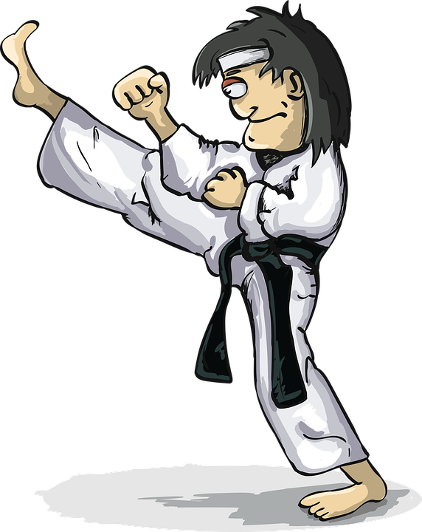
Knife Skills
An Interactive Workbook
Original copy by: Camelle Kinney & David Travis, Lincoln Nebraska
Adapted by: Barbara Scully
Notes:
National Family & Consumer Sciences Standards:
9.0: Food Science, Nutrition & Dietetics
9.2.5: Demonstrate practices and procedures that assure personal and workplace health and hygiene.
Common Core State Standards:
RST.9-10.3: Follow precisely a multi-step procedure when carrying out experiments, taking measurements, or performing technical tasks, attending to special cases or exceptions defined in the text

Slide 2
Before we even begin
Your teachers have a
When it comes to ‘messing around’ with knives.
Notes:
Anticipatory Set:
Using a chef’s knife, demonstrate how to cut up a carrot into even slices.
Instructional Content:
Watch and take notes using this PowerPoint guide. There are video links to YouTube within the PowerPoint.

Slide 3
Basic knife safety
Do not SWORD FIGHT or look like you are going to.
Do not throw, toss or attempt to juggle
These knives are in fact sharp, and will cut you. You do not want to get stitches.
If you are or look like you might be ‘messing around’ in any way that your teacher might perceive as dangerous you will be removed from class. NO WARNINGS.
Thank you for your cooperation
Notes:
Purpose:
Knives can be the most dangerous tool in the kitchen, yet they are essential for food preparation. Students will learn about and use a variety of knives for different purposes in the foods lab.

Slide 4
Knife Safety 101: How to hold a knife and care for your knives
Notes:
Safety Tip:
Always use the correct knife for the task.
Never use a knife to perform inappropriate tasks, such as opening a can or bottle. Doing so could damage the knife and injure you.
Always use a sharp knife. More accidents happen when using a dull knife because it may require more force.

Slide 5
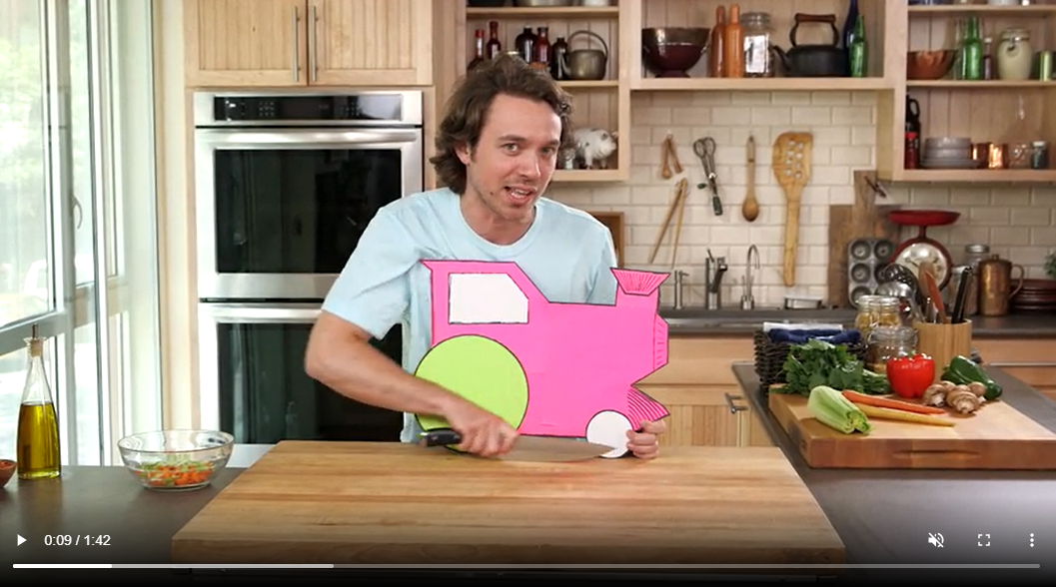
Cutting tips: Rocking hand CHOO CHOO motion
Ctrl & right click to follow embedded link on picture
Notes:
Cutting tips:
Always cut slowly and with care.
Cut away from the body.
Make sure to cut with dry hands to prevent slippage
Keep distractions out of the kitchen when you are chopping.
Pay attention as you chop to prevent injury.
Any time you are chopping fruits and vegetables, chop in half first to create a flat surface. This will give you better control so the food won’t roll under the knife.

Slide 6
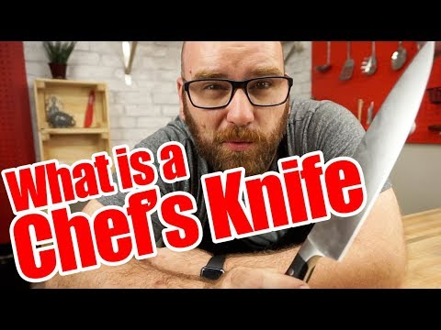
The Anatomy of a Chefs Knife
Notes:
Chef’s Knife
Largest knife in the kitchen.
Usually 8 – 10” long.
Should feel comfortable and balanced in your hand.
Select a chef’s knife with a full tang, meaning that the blade should go completely through the handle to promote long wear and stability.
Use the chef’s knife to cut any food that would be chopped or minced or needing a cutting board including herbs, slicing watermelon, cutting all types of fruits and veggies and more!
Paring Knife:
Small blade – 2 1⁄2 - 4” long
Mainly used for peeling fruits and vegetables
Also used to create garnishes
Serrated Bread Knife:
Must be very sharp to slice bread.
Blade must be at least 7” long, but preferably 9” to adequately slice bread – the longer the blade, the cleaner the slice.
Serrated knife allows bread to be sliced easily.
Bread knives can also be effective for cutting tomatoes.

Slide 7
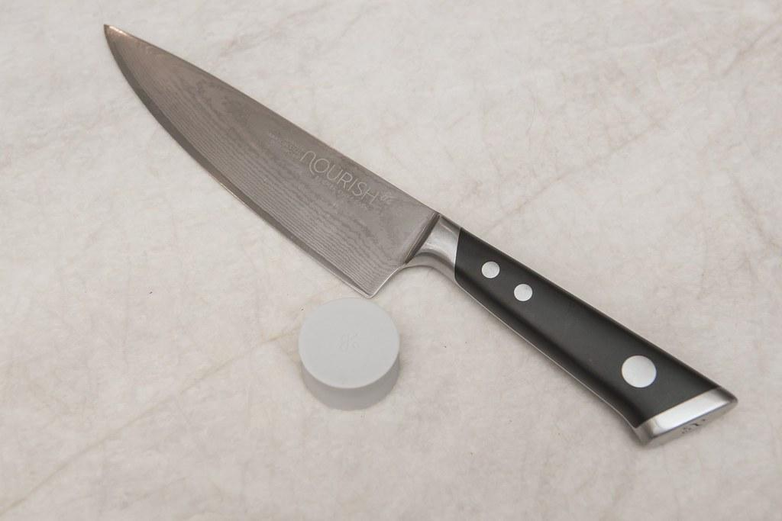
Use the words below to correctly label the anatomy of a knife
Spine
Tang
Rivet
Tip
Cutting edge
Bolster
Handle

Slide 8
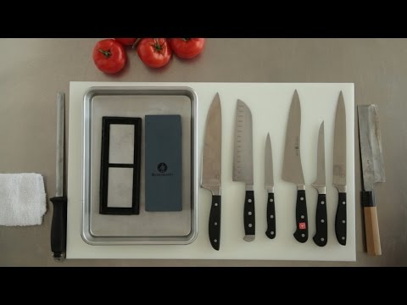
Four must-have kitchen knives
Notes:
Cutting Board Tips:
Use a clean wooden, bamboo or plastic cutting board.
Avoid glass, ceramic and marble cutting surfaces. They dull knives.
Stabilize the cutting board by placing a flattened damp towel under it. This will prevent the board from slipping.

Slide 9
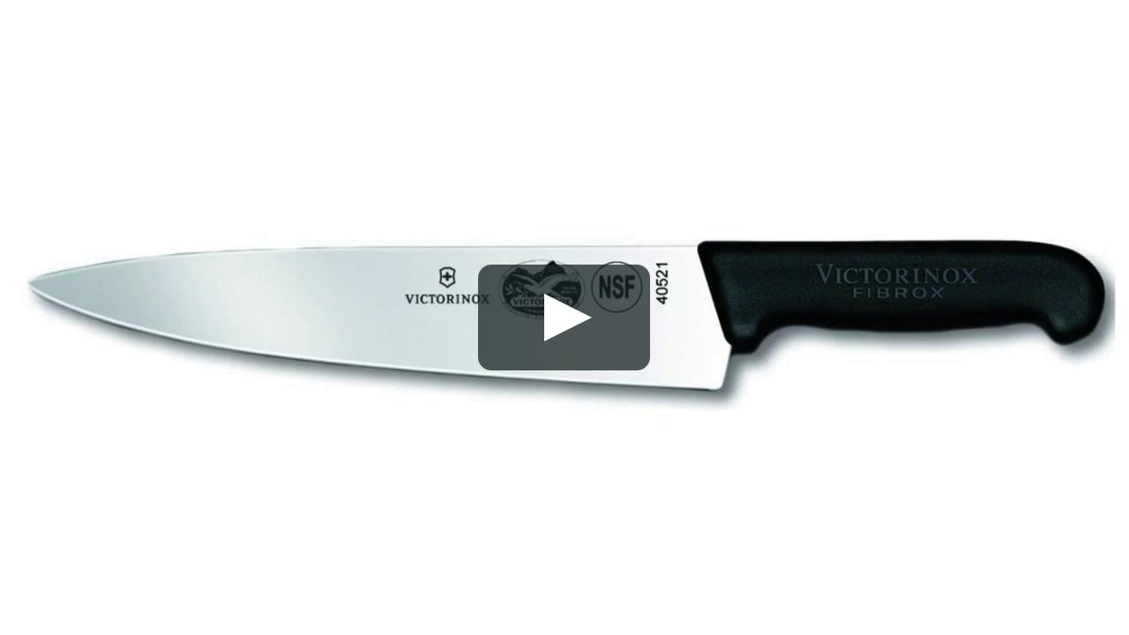
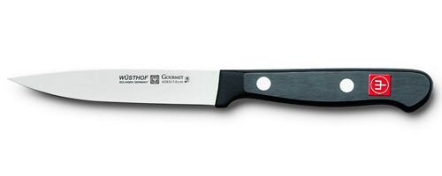
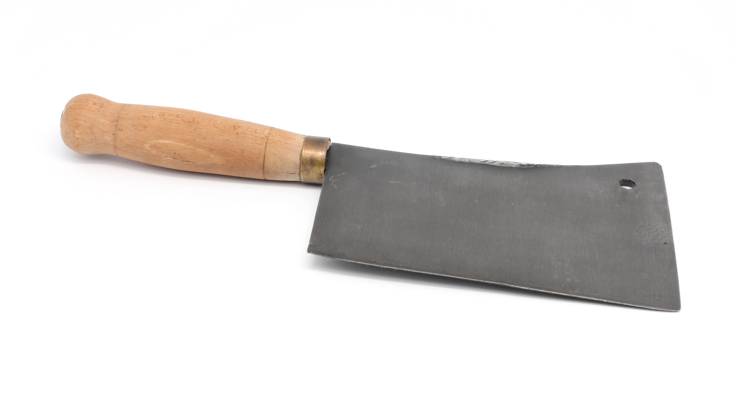
Name of Knife | Picture of knife (drag and drop the picture) | What is the job and purpose of this knife
Chef Knife
Paring Knife
Serrated Knife
Granton Blade Santoku
Cleaver
Tourne`

Slide 10
Review: Kitchen knives
More fun with knives:
What is the name of the knife that has teeth?
Other than slicing, what other use does a paring knife have?
What is the name of the knife that has a long, wide blade?
What is the name of the blade that is flexible enough to easily cut meat, poultry and fish off of the bone?
How should you always clean your knives after using? (Dishwasher or Hand wash?) Explain.

Slide 11
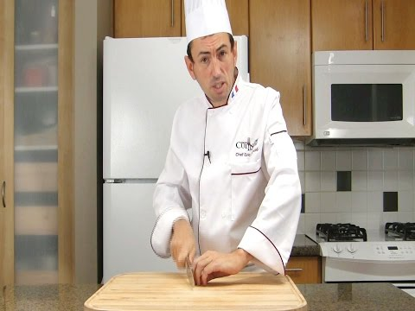
Knife safety: Knives are one of the most dangerous items in the kitchen. Learn how to safely use them.
Watch the video and list 5 safety tips given in it
1
2
3
4
5
Notes:
Safety Tips:
Always use the correct knife for the task.
Never use a knife to perform inappropriate tasks, such as opening a can or bottle. Doing so could damage the knife and injure you.
Always use a sharp knife. More accidents happen when using a dull knife because it may require more force.

Slide 12
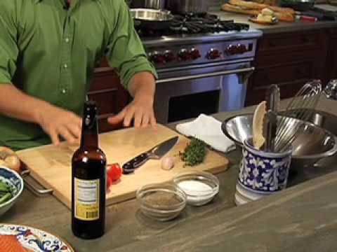
Mis en Place… What does that mean and how can you apply it in the kitchen?
Define ‘mis en place’ AND describe how you can ‘mis en place’ in the kitchen below.

Slide 13
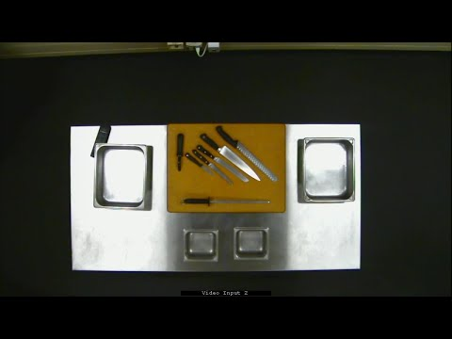
Knife station setup: Watch the video below, and complete the next slide.

Slide 14
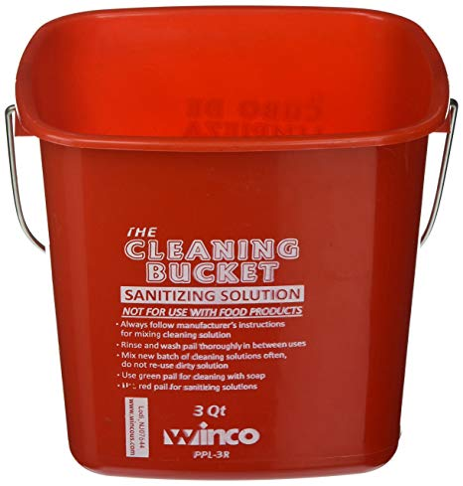
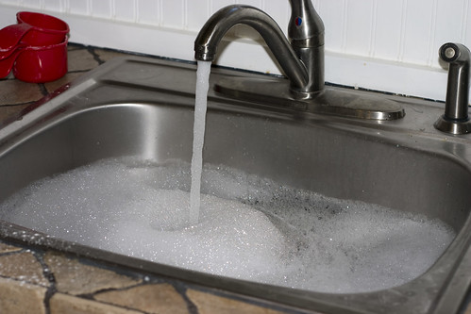
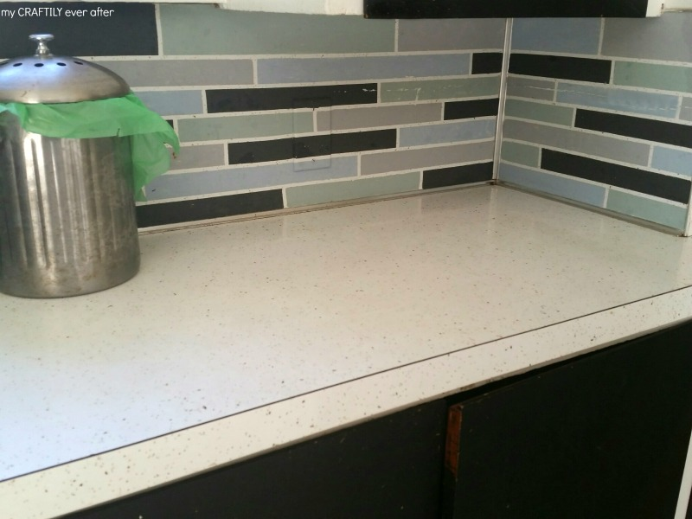
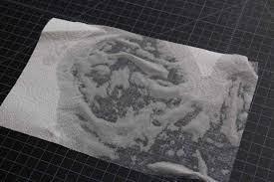
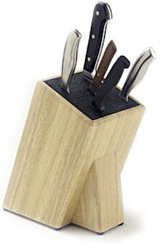
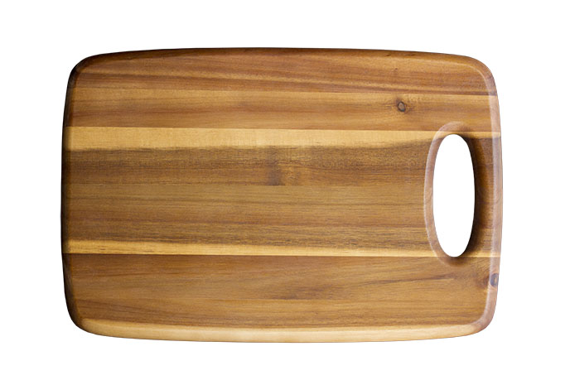
Below are pictures needed for setting up your knife station. Organize the pictures explaining why you need the items to correctly setting up your knife station. Demonstrate understanding.
1.
2.
3.
4.
5.
6.
Notes:
Cutting Board Safety & Sanitation:
Always use a clean and sanitized cutting board.
Sanitize the meat cutting board with a solution of a tablespoon of chlorine bleach to one gallon of water.
Replace the cutting board when it develops significant grooves. Disease causing bacteria can grow in the grooves.

Slide 15
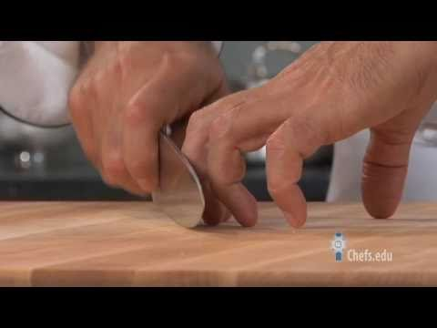
How to hold a knife: Watch the video and list 5 important things to remember.
5 things to remember
1
2
3
4
5
Notes:
Using the knife to chop:
Use your non-dominant hand (guiding hand) in a “claw” to stabilize the food to be cut.
Using the “claw” will prevent your fingers from being cut. The link below will show you how to hold your other hand to keep it safe.
As you chop, use the dominant hand to rock the knife without lifting it.
The guiding hand (using “the claw”) will move the food toward the knife as you chop.

Slide 16
Knife Cut | Size | Use
Mince
Julienne
Brunoise
Dice | Small: Medium: Large:
Stick | Batonnet:
Round/ Rondelle

Slide 17
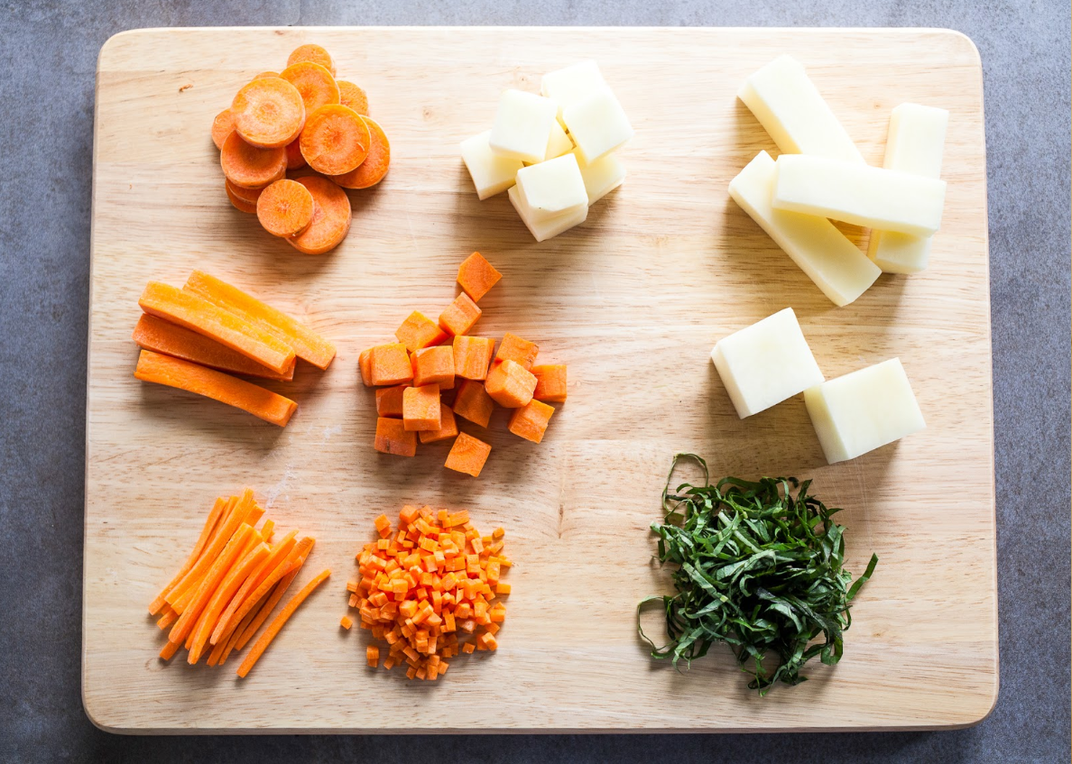
Brunoise
Chiffonade
Cube
Julienne
Small Dice
Medium Dice
French Fry
Chop
Stick
Round
Slice

Slide 18
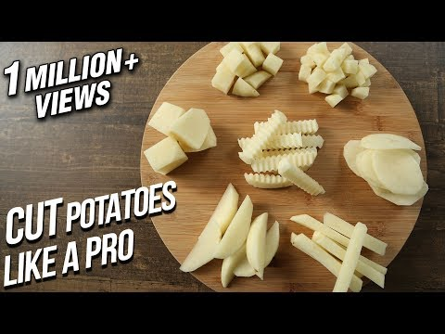
Potatoes:
Let’s do lots of practice on potatoes! Lets get some great cuts!
1.
2.
3.
4.
5.
Why should you place the peeled potatoes into a bowl of water as you work with them?
Why should you slice off a small bit of potato on the side before you begin your actual knife cuts?
What do you notice about the fingers on the cook’s guiding hand?
What are the three sizes of dice?
What kind of knife is used to make crinkle cut potatoes?

Slide 19
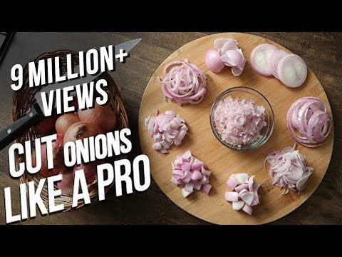
Onions: One of the most used ingredients used in a chef’s kitchen. They add flavor to many foods. Learn to cut onions like a pro!
1.
2.
3.
4.
5.
Why is a wet towel placed under the cutting board?
If you want to get fast at knife work, what should you do?
Do you cut all of the way through an onion at first if you are chopping it?
Describe how to do the “Rocking Motion”.
Which onion cut requires a different way of peeling the onion before you begin?

Slide 20
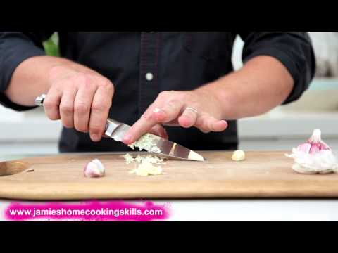
Garlic: Its like Jelly to Peanut Butter… If there are onions, there is often garlic in the same recipe.
Jamie Oliver (the chef in the video) shows 4 different ways to prepare garlic. Which way do you think would work best if were to wanting to make Garlic Bread. Why?

Slide 21
Exit Ticket: Knife Safety Online Quiz
Below I have shared my bit.ly link template.
Anyone with the link can duplicate
Included are the correct answers for immediate grading
https://bit.ly/3dXjoJ0
Notes:
Assessments:
Observe students using knives.
Knife Safety Quiz or Knife Safety Online Quiz

Slide 22
Lab Skills:
You will work independently to practice what you have just learned. You will need 1 potato and 1 carrot and 1 stalk of celery PER PERSON TOTAL.
Potatoes are generally easier to cut than carrots. You are encouraged to practice as many different cuts as you can. Choose your best cuts for the listed sizes. Take a picture of them and upload onto the next slide. Use your phone and send an email to your student account (yourself) or you can use laptop to take a picture and upload to your slide.
You must take a picture of a properly set up knife station
These lab activities will likely take you 3-4 days to complete. Do not rush through this activity. Your goal in these lab experiences is to practice important skills. The way you become fast at these skills is by PERFECTLY PRACTICING THEM. Not hurrying through them.

Slide 23
My knife Station:
Properly setup your knife station. You need to stand behind your knife station and have someone else take a picture of you in it. Then upload the picture here.

Slide 24
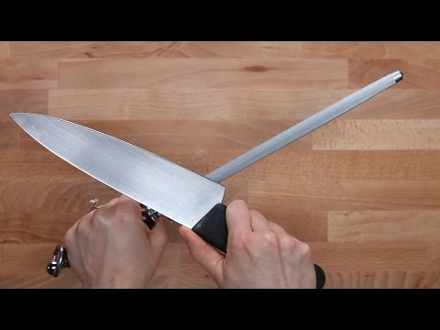
Steeling a knife:
Review how to hone & steel a knife. Practice doing that to a chef’s knife. Here is a short video on how to do this. After you reviewed this...try it out.

Slide 25
Celery Practice
Get one stalk of celery. Wash it, and trim the ends. Place the celery onto your cutting board. Make sure you have correctly setup your knife station.
This activity allows you to practice:
How to correctly hold the knife. Really feel the knife in your hand. Look at how you are holding it. Is it correct? If you’re not sure, ask your lab partner.
The CLAW hold with your non cutting hand. Check to see if you’re doing that.
The ‘Rocking Motion’ of cutting. Do not lift your knife off the cutting board. You should not hear “CHOP CHOP CHOP” sound, but rather a “SWOOSH SWOOSH SWOOSH” sound.
Practice on half the stalk of celery. Then, have someone video the other half. Sometimes, you learn quite a lot from seeing yourself do something.
Upload your video onto the next slide.

Slide 26
Celery Practice
This is where you upload your picture of your knife cut’s ‘slice, chop & dice’ using the celery stalk with you in the picture.

Slide 27
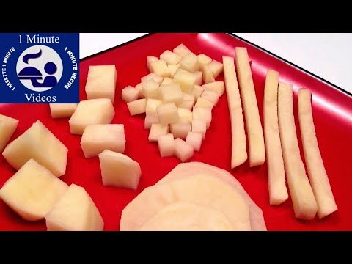
Watch this first:

Slide 28
Time to get serious about potato cuts
OK, you are ready to practice on a potato. Setup your knife station, get a potato and peel it. Then, try out some cuts. *REMEMBER, you need to square it off* (Make a flat surface on one side by cutting a small piece off) this allows the potato to lay flat on the cutting board.
Start making PLANKS, then STICKS then DICES.
2. Make 1 Video demonstrating all of the 5 styles of cuts. 3. Use the flipgrid app and insert the QR code on the next slide.

Slide 29
Potato Practice
This is where you upload your Flipgrid video QR code demonstrating the five styles of potato cuts: ‘Slice, Dice Julienne, chop & mince’.

Slide 30
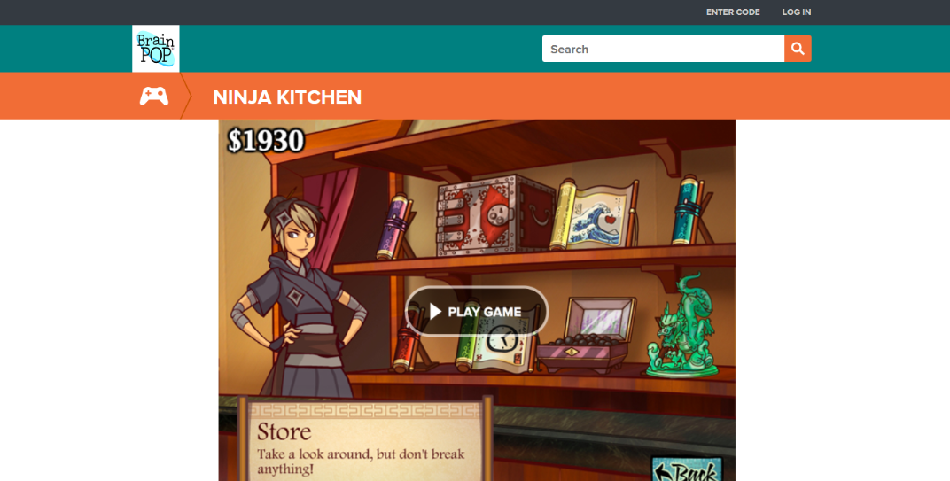
Ninja Kitchen interactive food service game. *Check it out. https://www.brainpop.com/games/ninjakitchen/

Slide 31
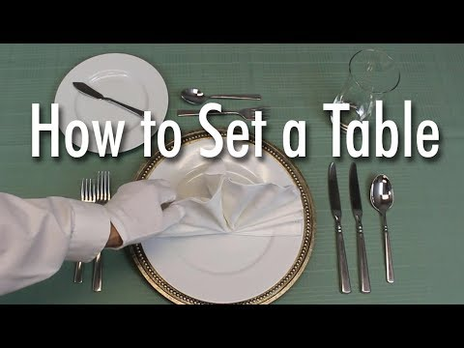
Learn to set a formal dinner table

Slide 32
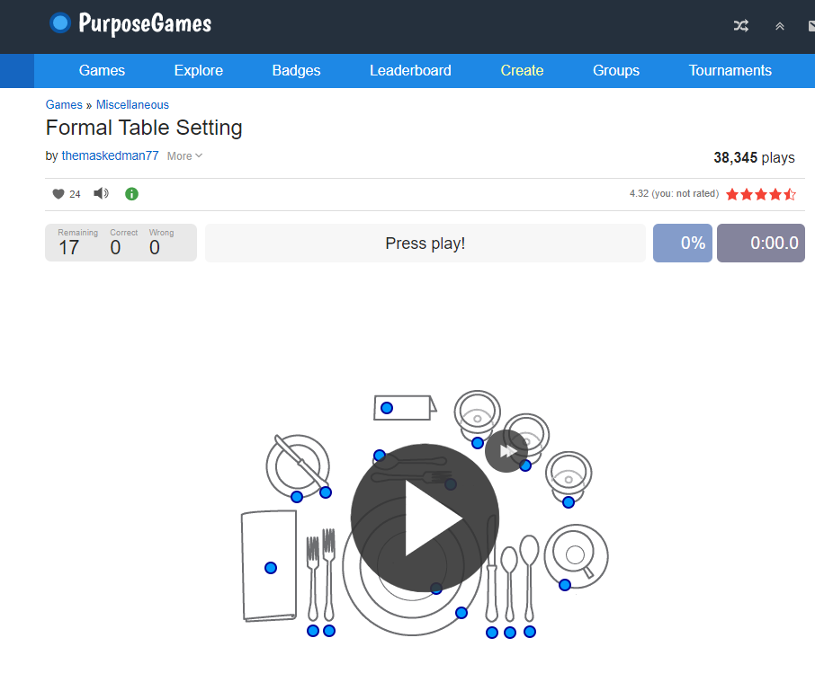
Apply what you Learned: Review table etiquette

Slide 33
Upload a screenshot of your 100% score to this slide

Slide 34
Upload a picture of your own place setting at the table.

Slide 35
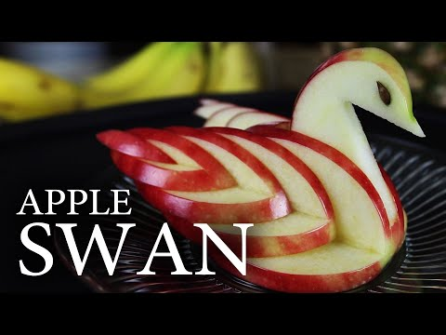
When you’re done…For FUN.
Apple Swans
Using the knife skills to create pretty garnishes and amazing fruit and vegetable sculptures is a lot of fun, and challenging. If you finished all of the required knife work (everything in the slides previous to this) by the due date. You may try your skills at an apple swan. To do this, watch the video below and look at the PDF link attached When you are ready to try this out, see me for an apple.
Step by Step instructions HERE

