Slide 1
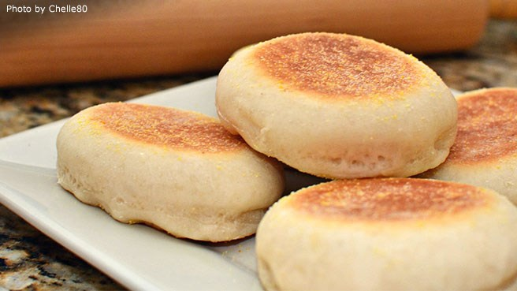
The English Muffin Challenge
By: Gracie

Slide 2
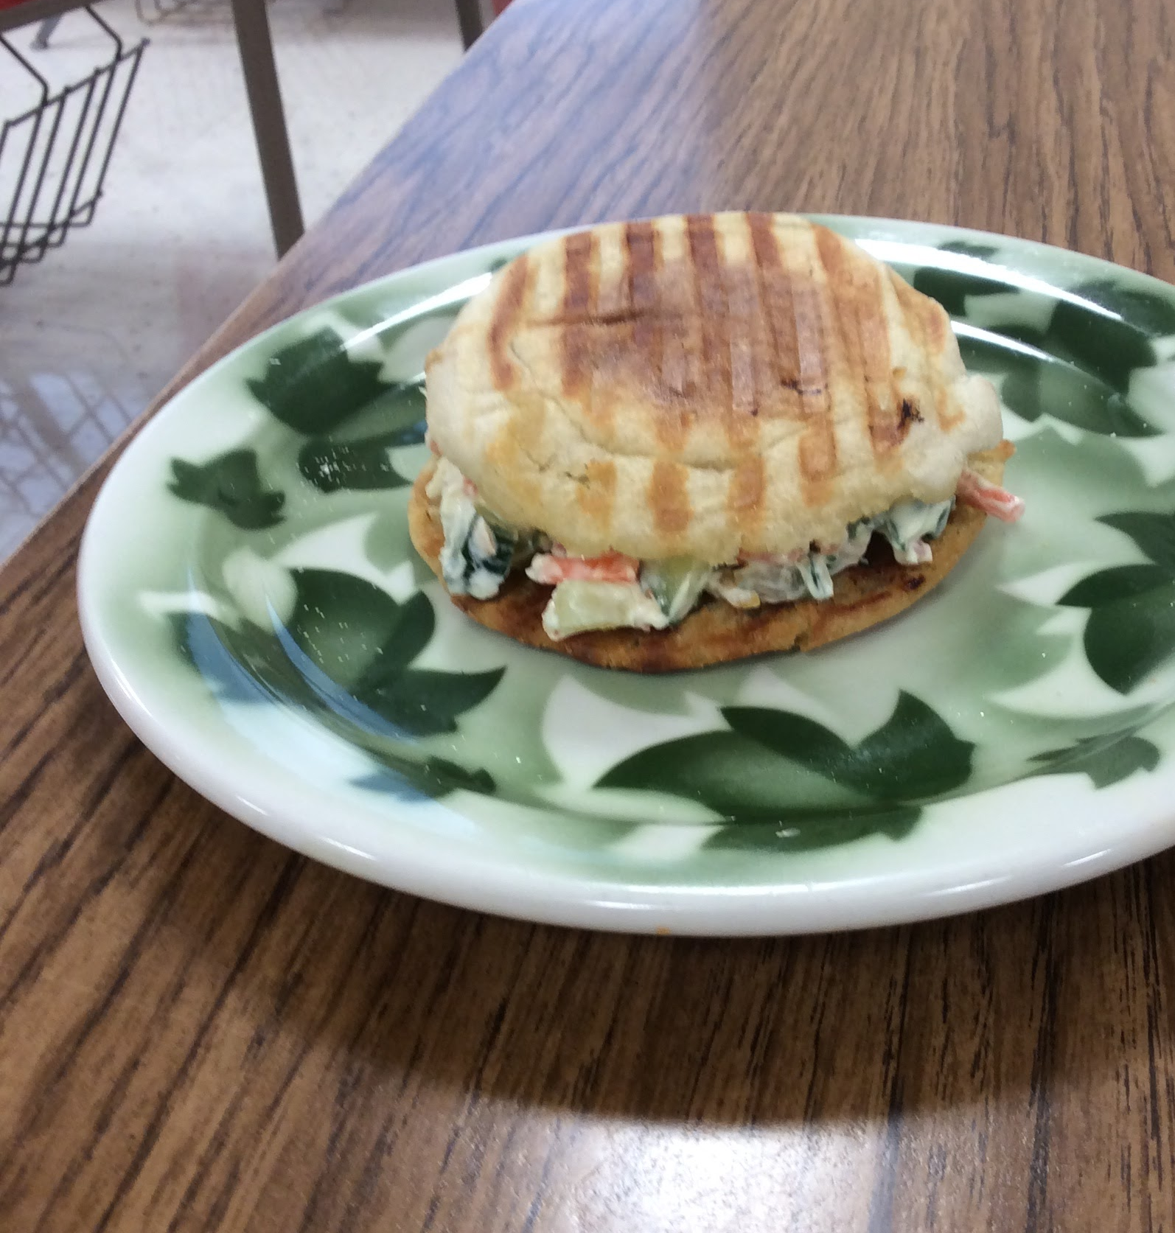
Introducing the …
Cream Cheese Veggie Panini
Add the BEST photo of your creation

Slide 3
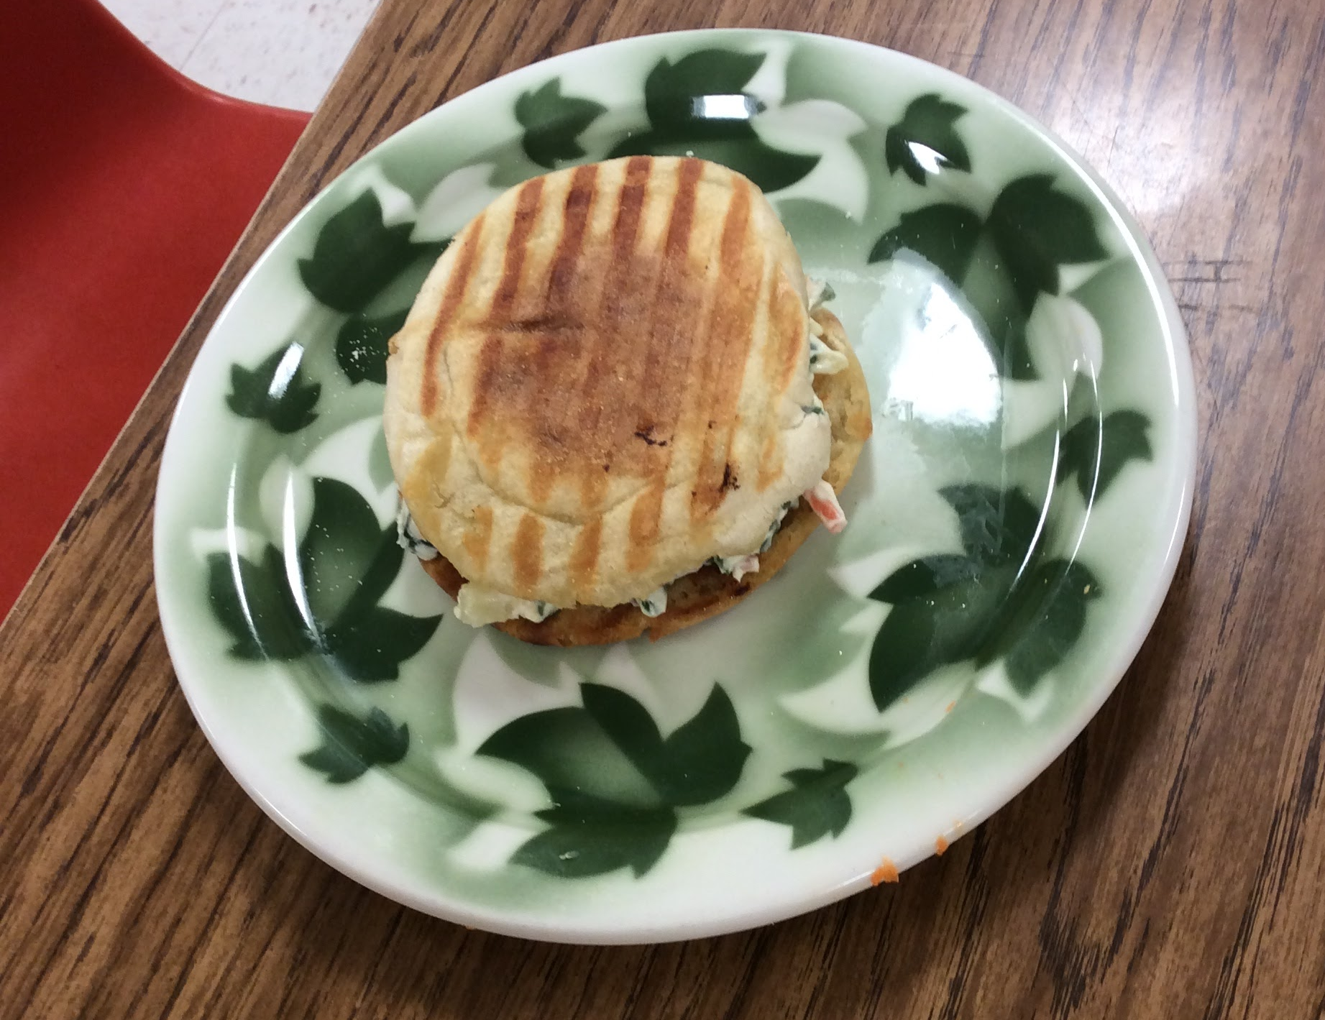
The sandwich tasted savory but sweet, and somewhat bitter.
The cream cheese made it taste savory. The cucumbers with their skin gave it a bitter taste. The carrots and bread gave it a sweet taste.

Slide 4
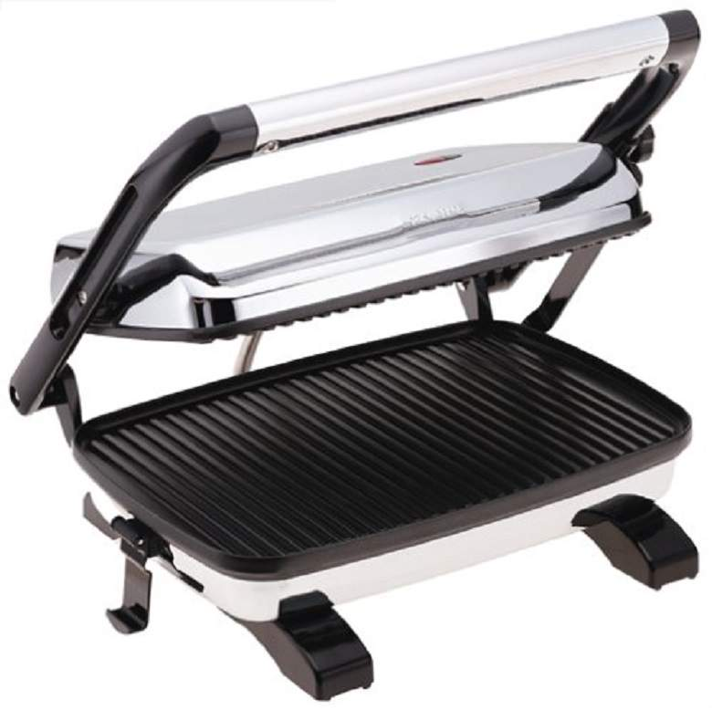
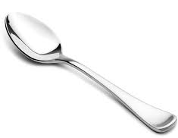
Panini press, spoon, and a small bowl.

Slide 5
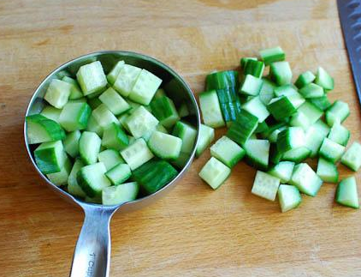
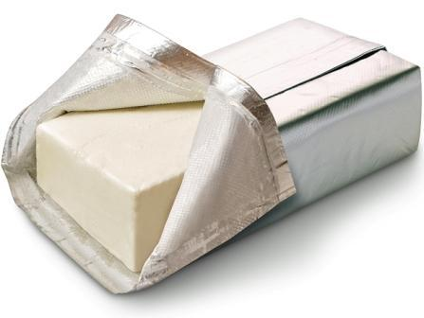
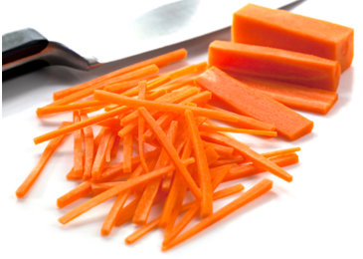
1 T. cream cheese
½ T. of carrots
½ T. cucumber
Few leaves of spinach
1 tsp. Shredded cheese
1 tsp. butter

Slide 6
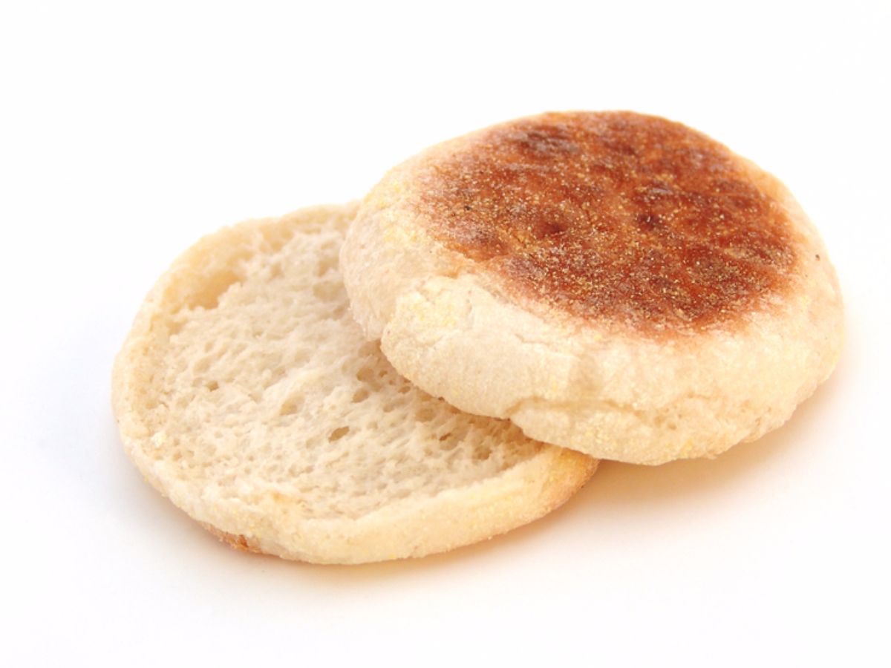
Directions--
Step #1
Split apart the English muffin into two equal halves and butter both sides of each English muffin. Put English muffin halves in the panini press for 3-5 minutes until they have golden brown lines across them.

Slide 7
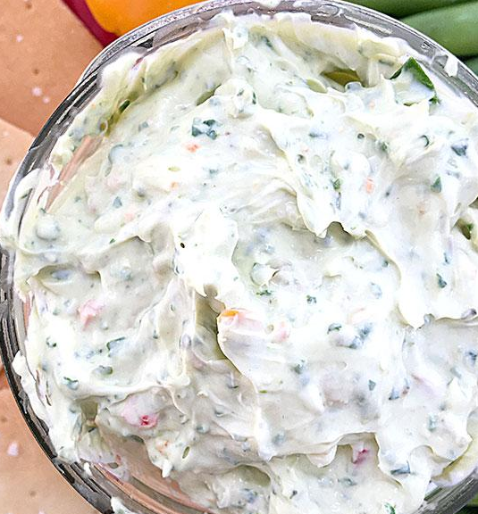
Step #2
Combine cream cheese, carrots, cucumbers, cut up spinach, and shredded cheese in a bowl. Stir together with a spoon until well combined.

Slide 8
Step #3
Spread mixture over one half of the English muffin and put top mufflin on. Enjoy!

Slide 9
When might you serve this food?
I would probably serve this for lunch.

Slide 10
Substitutions that could be made to this creation include...
It would be good if the cucumbers were substituted with broccoli.

Slide 11
What did you learn from this challenge?
I learned to be creative and it is surprising what you can come up with in a little amount of time and a few ingredients. Some things that you may not think taste good together may actually.

Slide 12
Is the final product as you imagined? Explain
It is pretty much what I expected because I was thinking about a vegetable pizza when I made it, and that it what it sort of tasted like.

Slide 13
How can the skills you used to create this dish be used in future creations?
The panini press can be used for several other dishes. It gives the bread a nice crunch. It is neat to put several ingredients together and see what you can come up with.

Slide 14
What changes might you make if you made this again?
I would probably melt the cheese on the English muffin instead of adding it into the cream cheese mixture with the vegetables.

Slide 15
How realistic was this challenge? Could this happen in real life?
This could very well happen in real life and it was a realistic challenge. There are probably going to be times in the future when you are limited on time and you only have a few ingredients in the kitchen. It is simple to make dishes out of various ingredients…it just may take some creativity.

