Slide 1
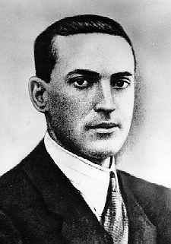
Lev Vygotsky
Cognitive Development Theory

Slide 2
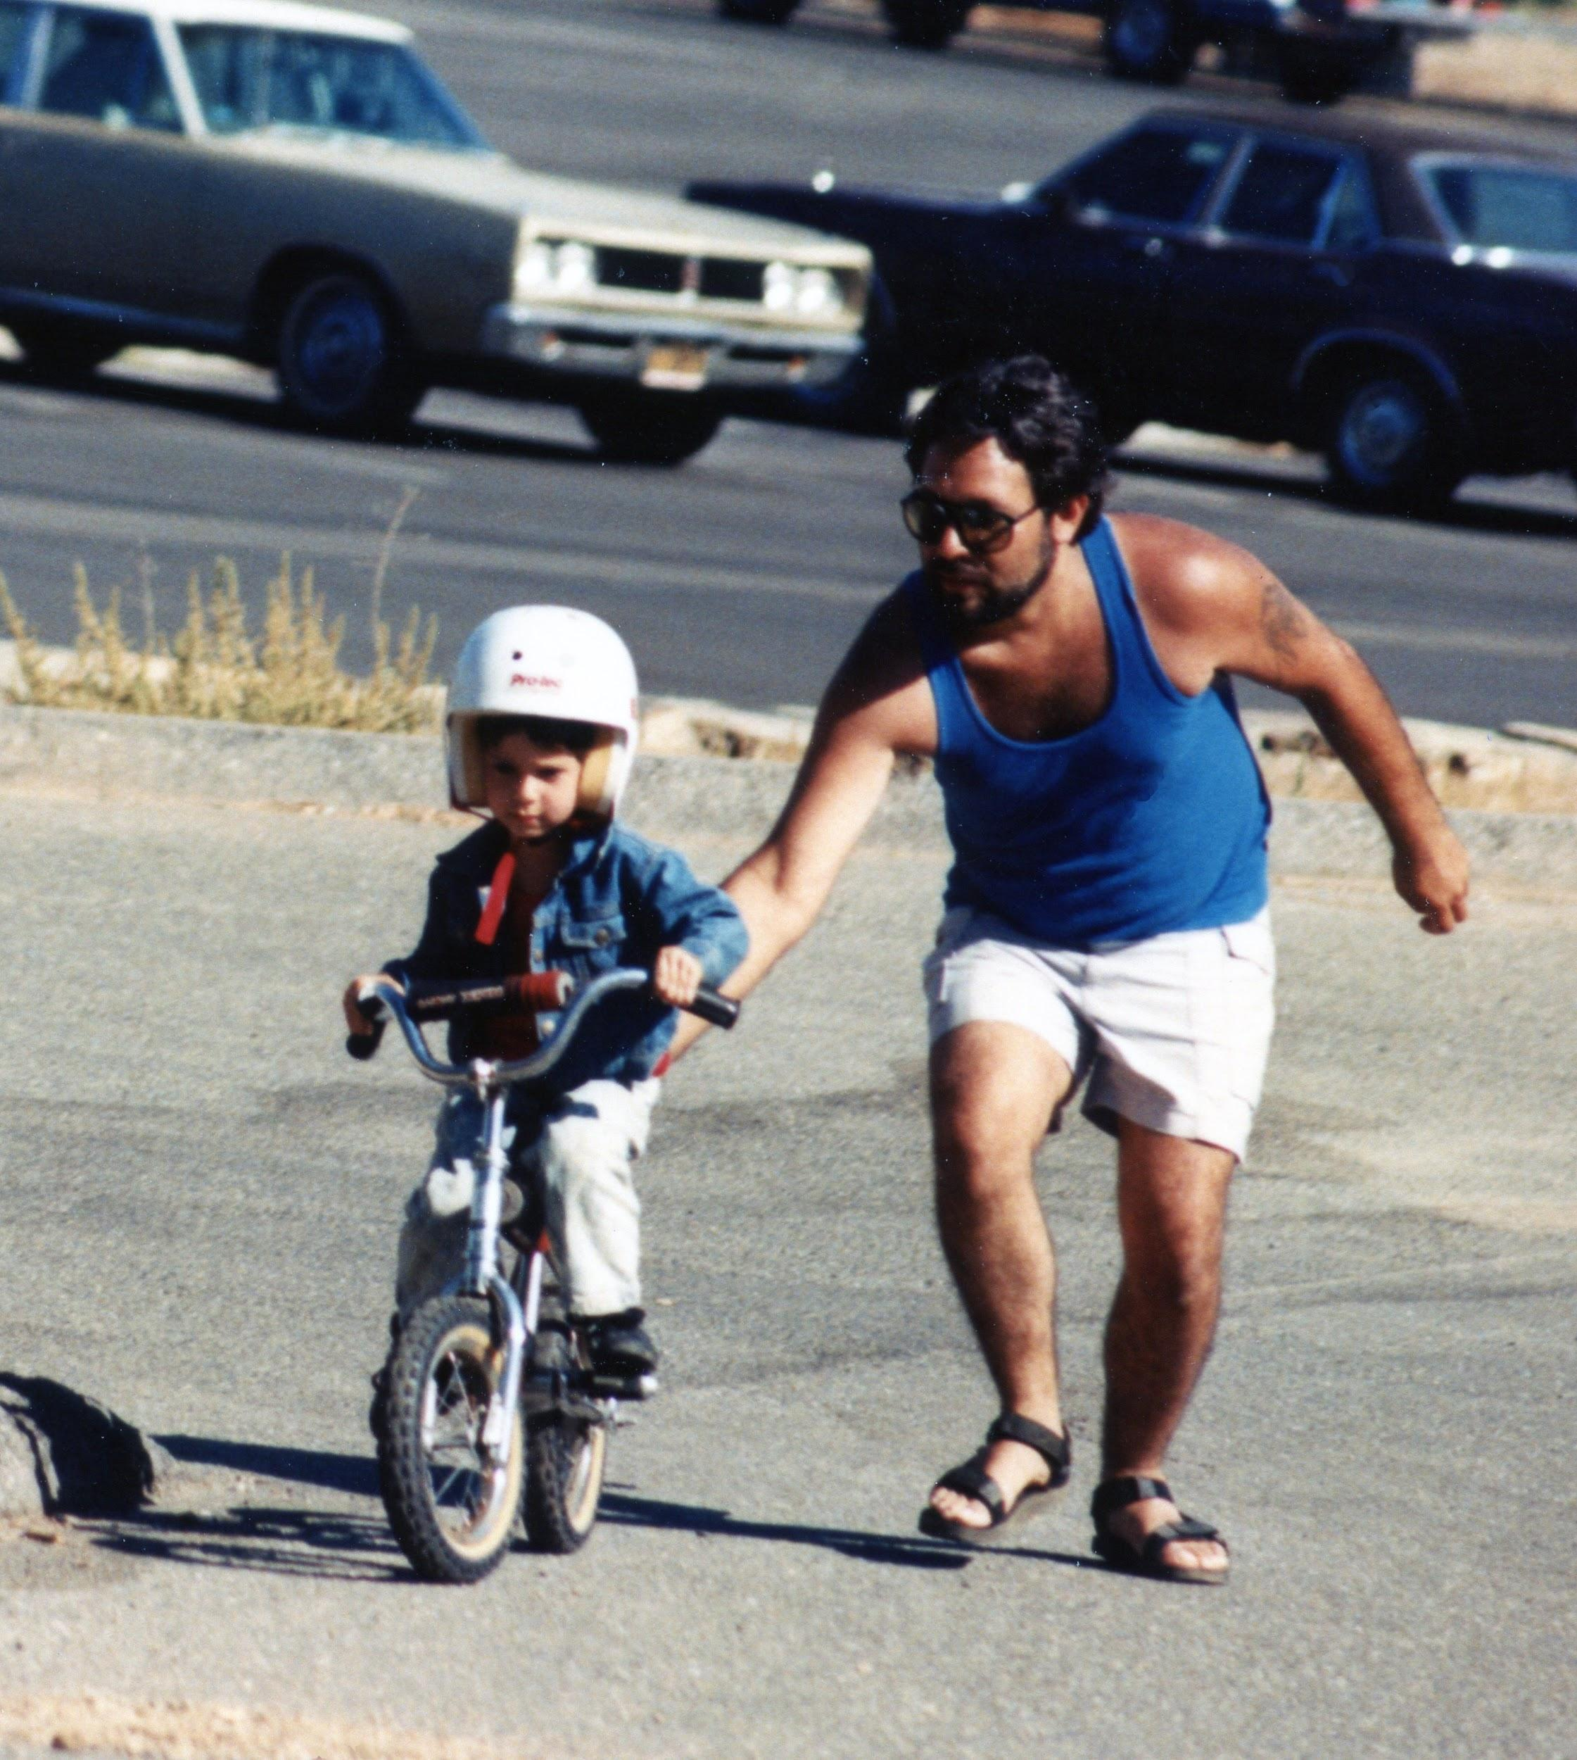
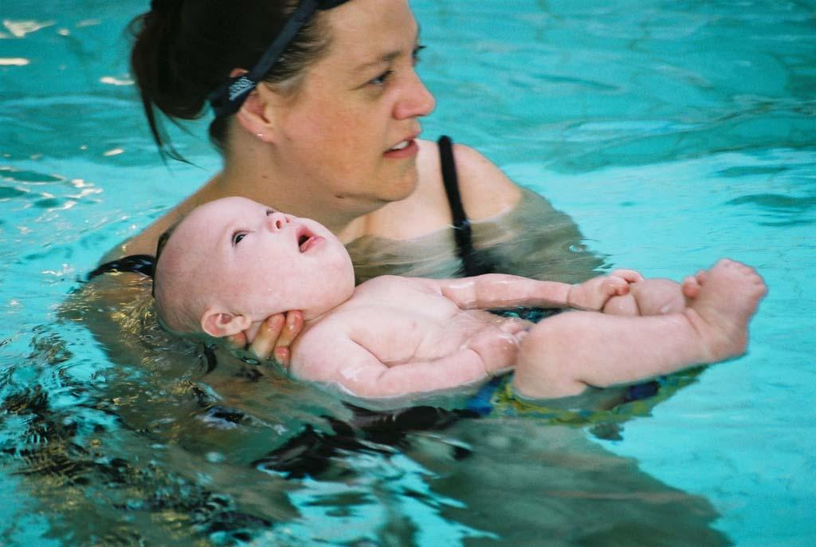
Planes of Learning
Vygotsky’s theory shows us that many of the skills we learn in life are first taught to us by someone else, typically a parent or caregiver. This is known as the Social Plane. Examples:

Slide 3
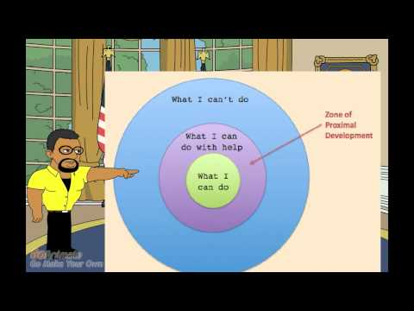
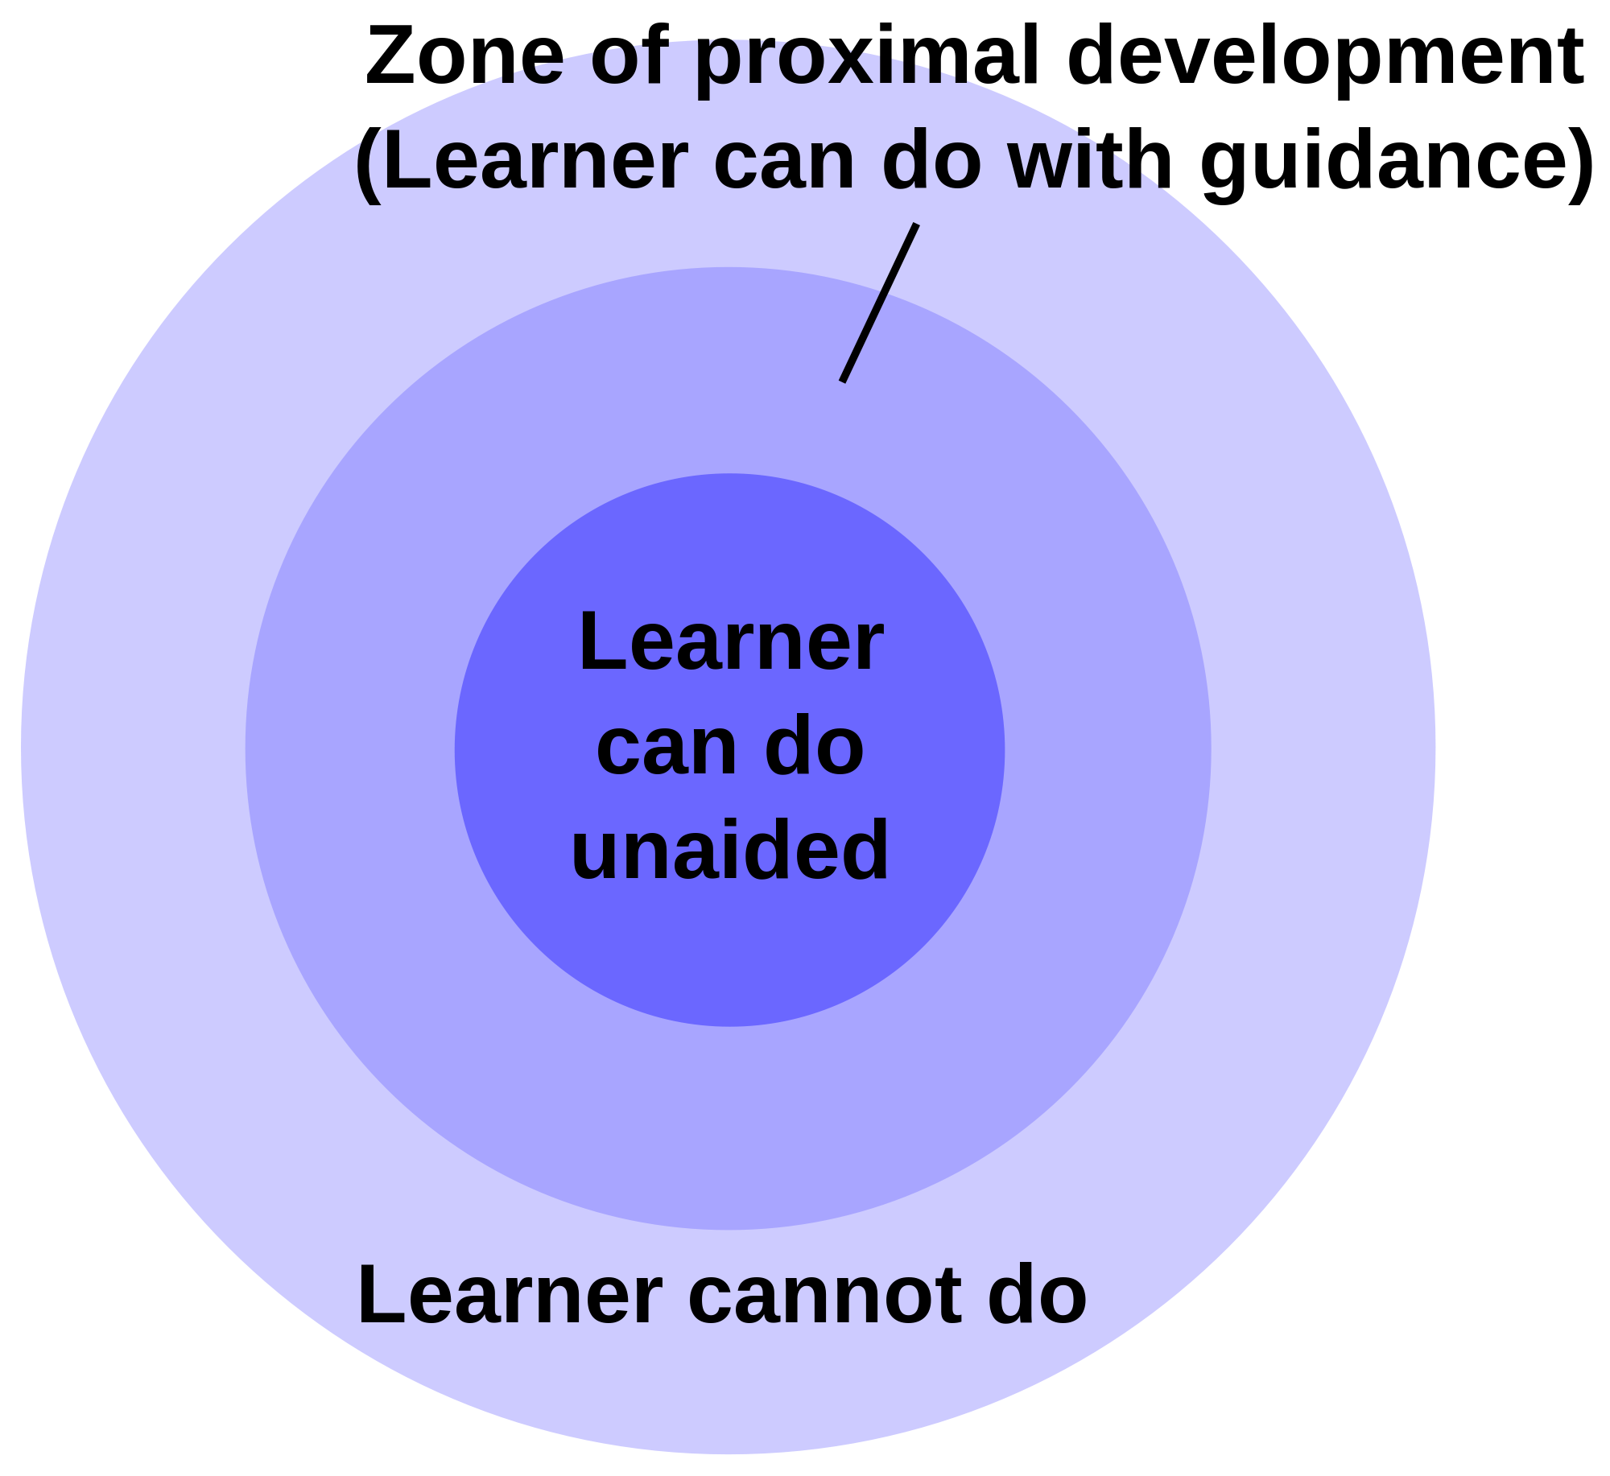
Zone of Proximal Development
As children interact with the adult, parent or caregiver, learning this new skill or knowledge they internalize it and make it their own. Gradually the adult, parent or caregiver will provide less and less “scaffolding” until the child can do it by themselves.
This is known as the Zone of Proximal Development--usually the support/interaction is greater at the beginning and lessens as the child learns/internalizes the skill.

Slide 4
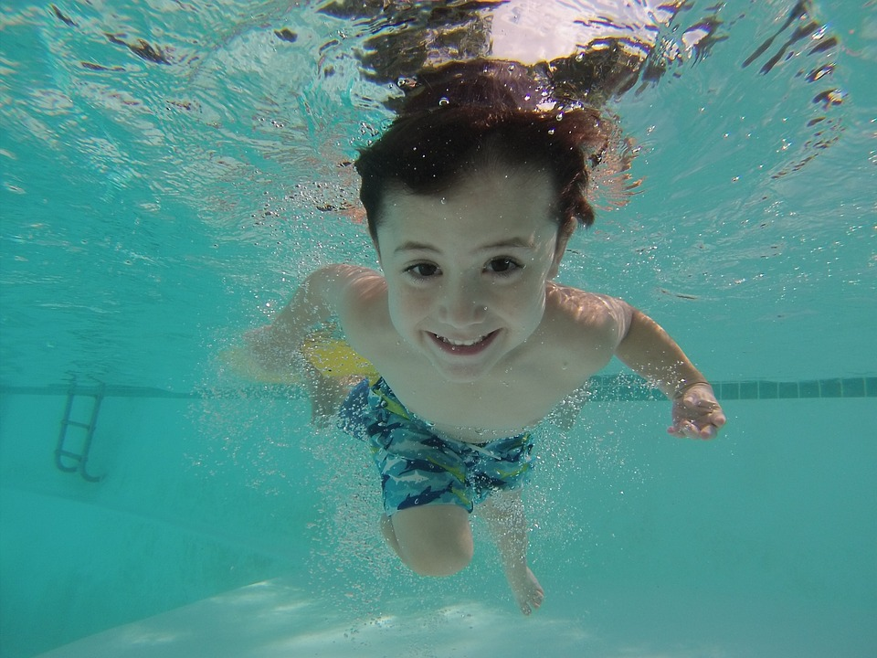
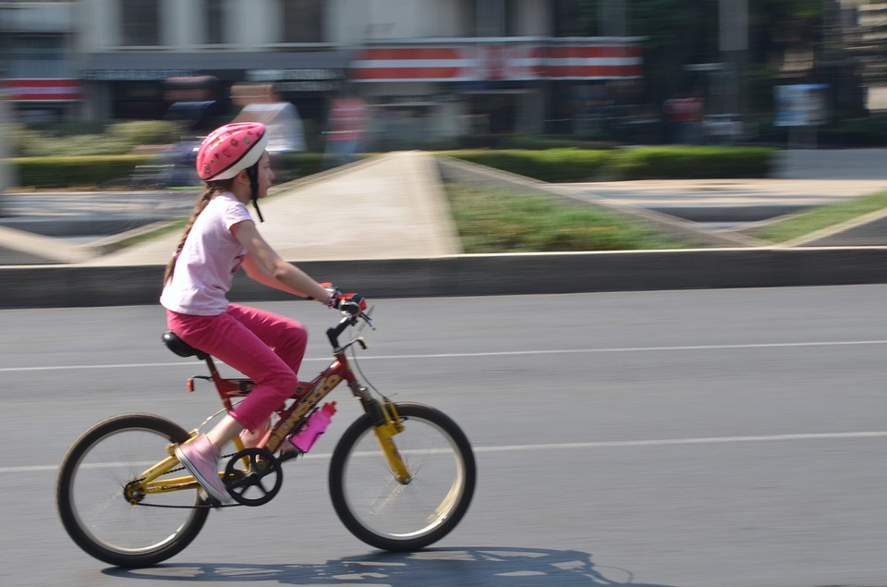
Planes of Learning Continued
Once the child has learned/internalized the skill or concept and made it their own they no longer need the “scaffolding”. They can do the skill on their own. Skills will become more refined with practice. This is known as the Individual Plane. Examples:

Slide 5
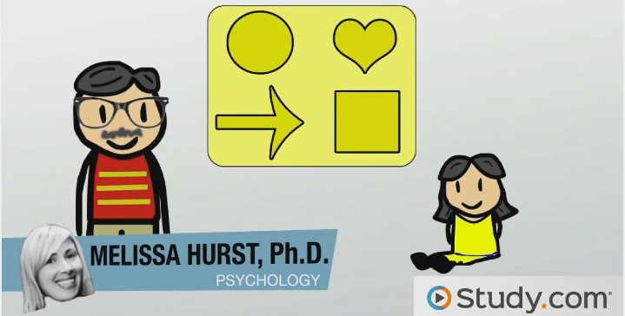
Overview
https://www.youtube.com/watch?v=k4mbavO96oM

Slide 6
Social Plane to Individual Plane
Brainstorm a list of skills you needed help from an adult to learn to do but know you can do them very well on your own. Choose one of the skills to complete the poster or Instagram assignment.

