Slide 1
Functions of the Family

Slide 2
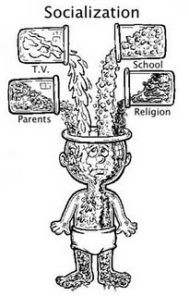
Socialization
Teach morals & values
Teach manners
Teach the difference between right & wrong
Teach what is acceptable & appropriate in school/society.
View this clip to see how well this was taught? We’re only as good as our role models.
https://www.youtube.com/watch?v=F66SApyDKa8

Slide 3
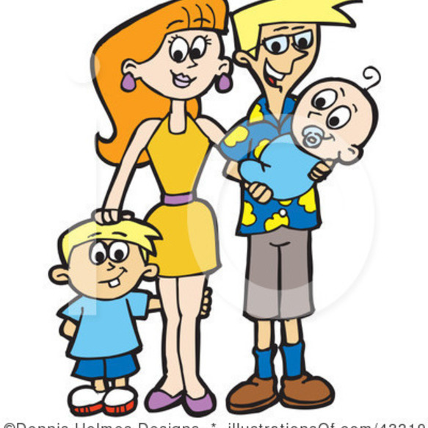
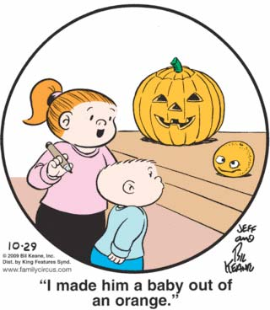
Procreation
It’s the family we form as adults
Having children
The family we raise our children in.

Slide 4
Economic
Having money to pay for needs and wants. Money can be earned through a job or inherited via a family member or even won such as a lottery (although less likely to occur for most families).
Money is budgeted for necessary expenses.
Needs are priority, wants are an extra and are not necessary.

Slide 5
Education
See that children go to school and get an education.
Provide children with learning experiences such as going to libraries, museums, and science centers, etc.

Slide 6
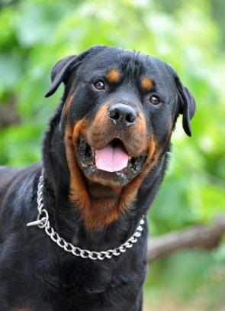
Protection
Keeping children safe from harm.
Following safety guidelines and laws.
Safeguarding your home with devices to keep harm out or reduce the risk.

Slide 7
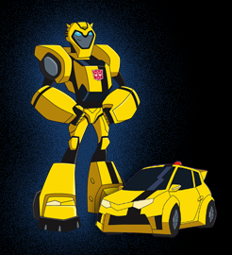
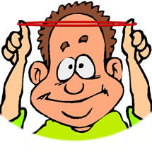
Adaptation
Trying to be flexible as new situations, crises and problems arise.
Knowing that schedules and routines can and will change and being able to “go with the flow”.
Being Resilient

Slide 8
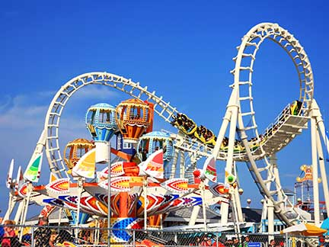
Recreation
Providing entertainment for children and the family as a whole.
Spending time together as a family doing fun things.
Can be free events or cost money, occur in and/or out of the home.

Slide 9
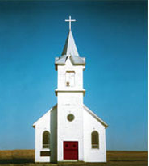
Religious Beliefs
Providing children/family with a religious or spiritual foundation in/out of the home. Ex. Daily devotions, going to Bible studies, etc.
Attending religious functions regularly such as going to church, youth groups, vacation Bible schools, etc.

Slide 10
Love & Support
Showing affection to your family members.
Telling them how you feel about them.
Asking, giving and receiving advice.
Sharing concerns.
Standing by family through thick and thin.
Loving unconditionally.

Slide 11
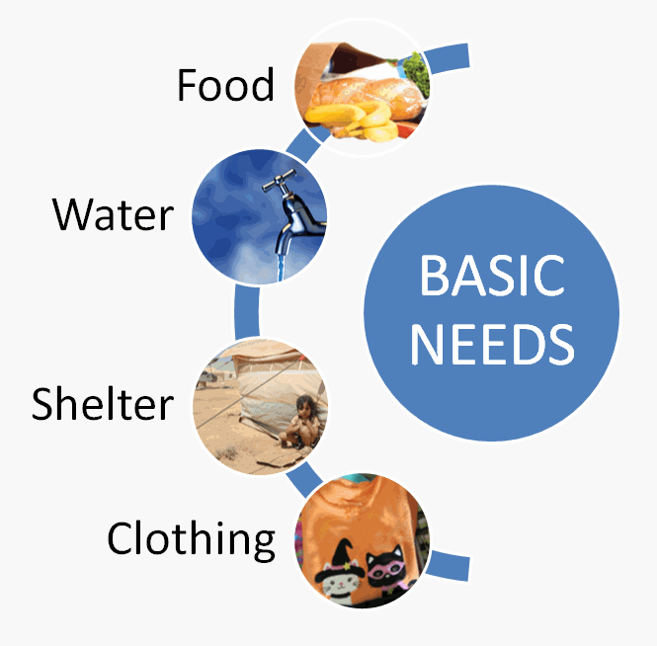
Providing Basic Needs
Providing a home (shelter), clothing and food to the best of your ability.
These are necessary for survival.
This does not mean it has to be the top of the line. Ex. Basic clothing based on need rather than on labels/designers.

