Slide 1
Food & Pregnancy
Child Development

Slide 2
Title this Picture

Slide 3
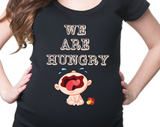
Myth or Fact
Pregnant women can eat “whatever” they want.

Slide 4
Foods During Pregnancy
Randomly select a food from the can. Use the internet to determine if the food or food category is safe to eat during pregnancy or if it should be avoided. You need to include:
Name of the Food & a Picture
Whether to Eat or Avoid
Briefly Explain & Give Guidelines

Slide 5
Motivator Poster Sample

Slide 6
Gallery Walk
Walk through the Gallery of posters and write down the information pertaining to each food on your Gallery Walk graphic organizer.

Slide 7
T-Chart
Using your Gallery Walk notes, create a T-Chart classifying FOODS to Eat or FOODS to AVOID

