Slide 1
Dessert Analysis
Count off by 5’s

Slide 2
#1 Dessert to Analyze

Slide 3
#2 Dessert to Analyze

Slide 4
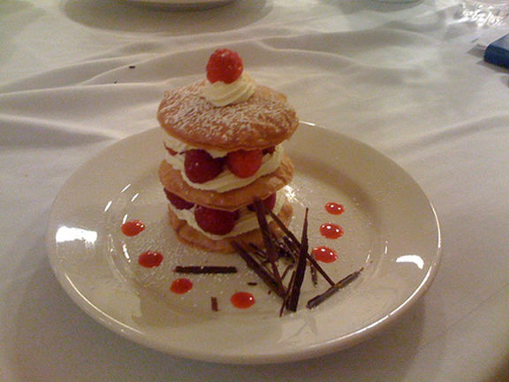
#3 Dessert to Analyze

Slide 5
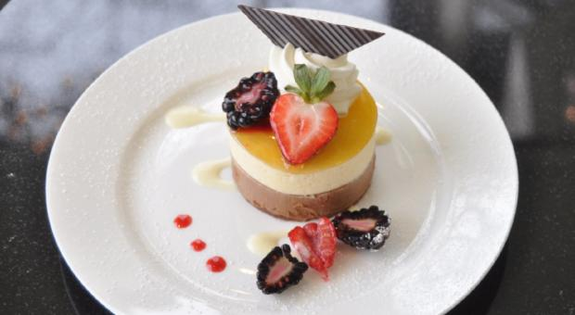
#4 Dessert to Analyze

Slide 6
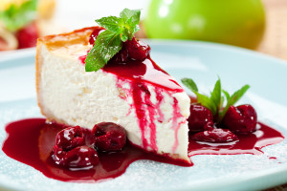
#5 Dessert Analysis

