Slide 1
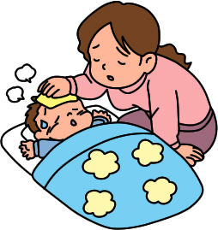
Caring for a Sick Child

Slide 2
How Do You Know?
Activity Level: Low if not feeling well
Appetite: Low if not feeling well
Skin Color: Pale or Gray if not feeling well
Temperature: Fever if not feeling well

Slide 3
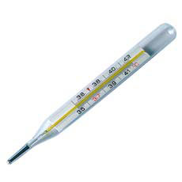
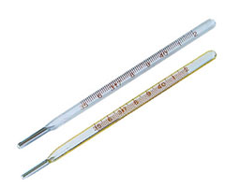
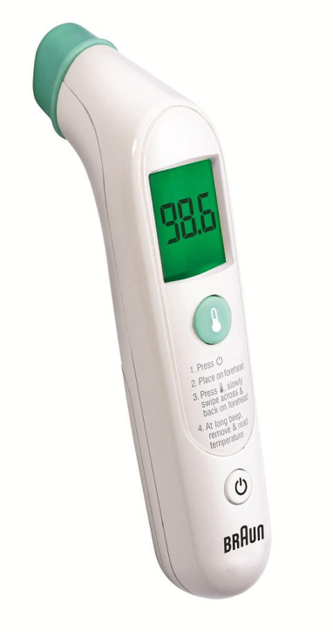
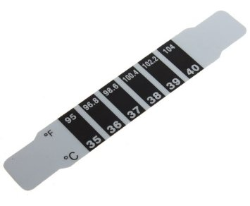
Identify the Pictures-What are They?

Slide 4
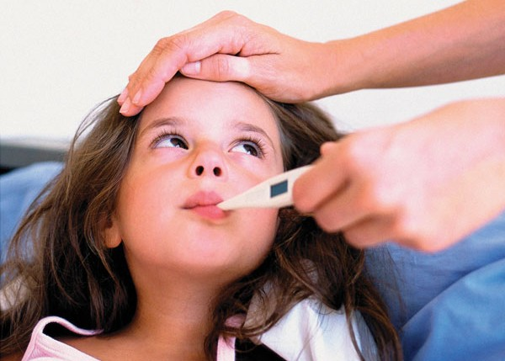
Thermometers
Ways to take a temperature:
rectal
armpit
forehead
ear
mouth

Slide 5
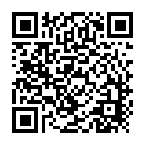
What are the Pros & Cons?
Mercury glass thermometers
Digital thermometers
Ear thermometers
Forehead thermometers
http://www.exposeknowledge.com/kb/8821-pros-and-cons-thermometers.aspx

Slide 6
How Read an Oral Thermometer

Slide 7
Example

Slide 8
Practice

Slide 9
Practice

Slide 10
Practice

Slide 11
Practice

Slide 12
Practice

Slide 13
Practice

Slide 14
Doctor for Children
Pediatrician

Slide 15
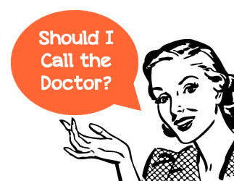
When Should You Call?
Put this quiz on the SMARTBOARD and have students individually take it and then review the correct answers.
http://www.babycenter.com/when-should-you-call-the-doctor-for-your-baby

Slide 16
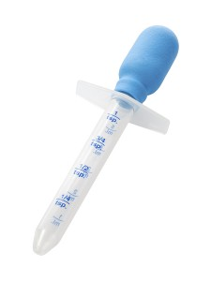
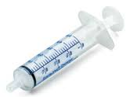
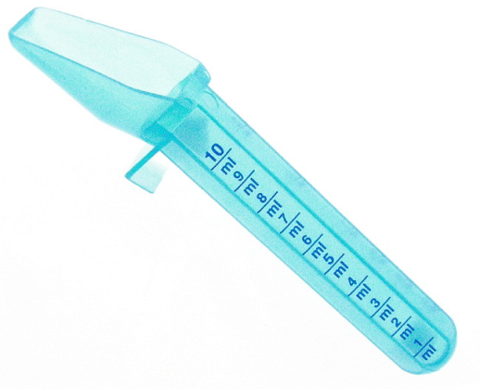
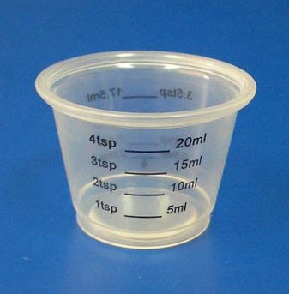
After Visiting the Doctor
You may have to use these…What are they?

Slide 17
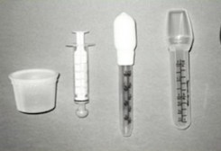
Tools for Dispensing Medicines
Oral Syringes/Pacifiers/Droppers
Medicine Spoons
Medicine Cups

Slide 18
What About This?

Slide 19
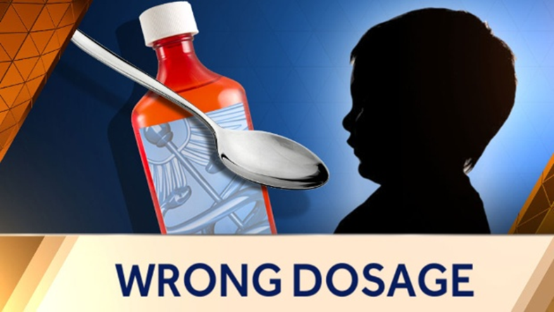
Never Use Kitchen Utensils or Measuring Spoons
Always use the correct tools.
Demonstrate the difference using the medicine dispensing tools vs the silverware teaspoon

Slide 20
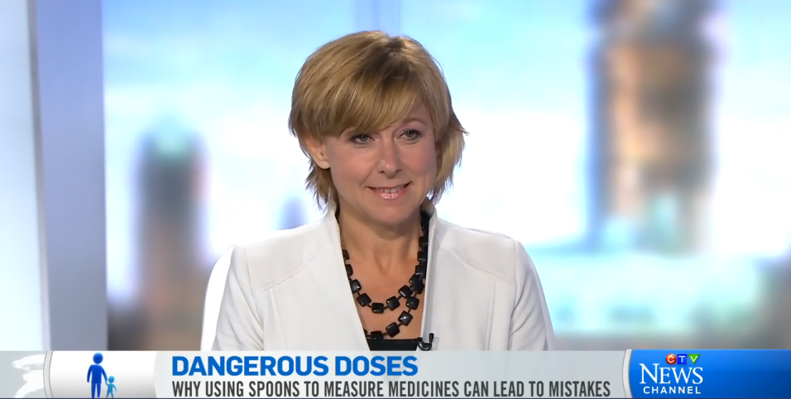
Why Measuring is Important
View https://www.youtube.com/watch?v=Syl724BKe4o

Slide 21
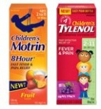
Practice
Complete the following worksheet:
Giving Medicines to Children

Slide 22
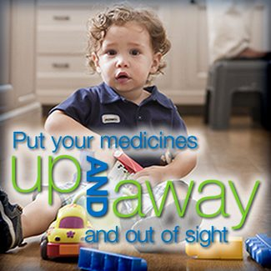
Storing Medicines Safely
https://www.youtube.com/watch?v=h5gmyQx_2Ls
Write down the safety tips as they are presented.
Where can you get more information?

