Slide 1
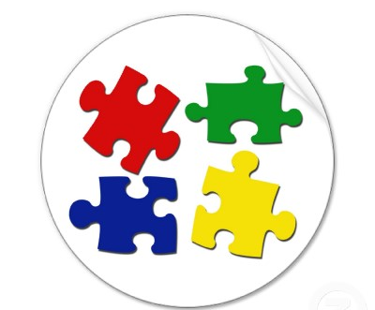
AREAS OF DEVELOPMENT
P I
E S
CHILD DEVELOPMENT

Slide 2
How is a child’s development like a jigsaw puzzle?
Each piece is important to the whole puzzle!
Individually the pieces are difficult to identify but when put together correctly, they form a beautiful, complete picture.
With the development of children, it’s difficult to discuss concepts concerning one of the areas of development without figuring out how it relates to the other areas of their development

Slide 3
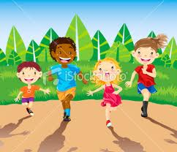
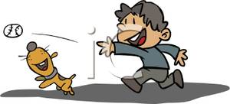
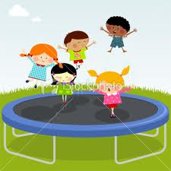
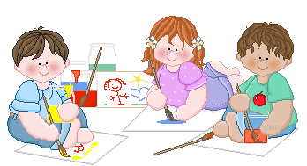
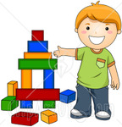
PHYSICAL
Having to do with the body & motor skills:
LARGE motor skills develop large muscles
SMALL motor skills develop eye/hand coordination

Slide 4
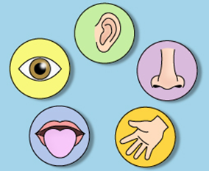
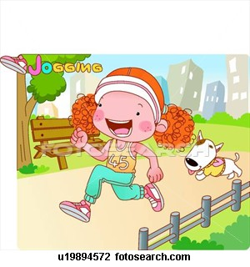
PHYSICAL CONTINUED…
Focuses on growth such as height & weight
Development of the senses
Physical development depends on opportunities to develop small/large motor skills & to maintain health through proper nutrition, exercise, rest and
medical care

Slide 5
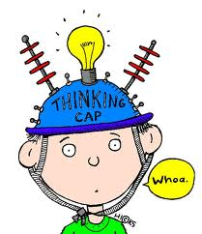
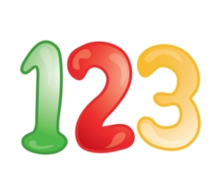
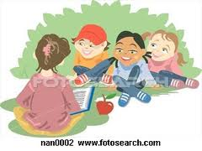
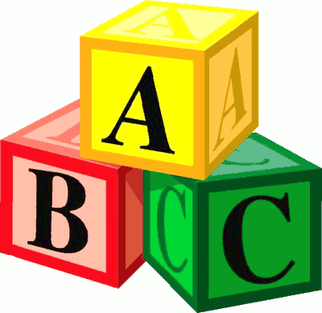
INTELLECTUAL
This area has to do with:
the mind & brain
learning & problem-solving
school concepts
creative thinking skills
language & literacy
moral development

Slide 6
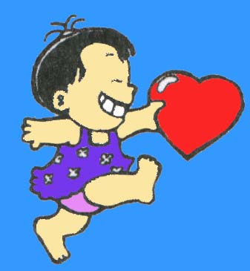
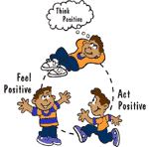
EMOTIONAL
Identifying and expressing feelings:
Understanding others feelings
Developing a positive self-concept

Slide 7
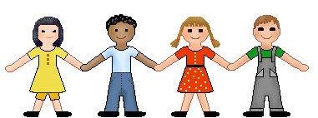
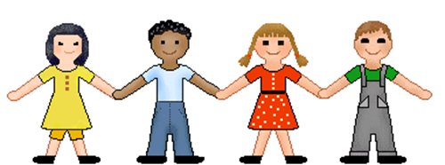
SOCIAL
Getting along with & interacting with others that includes:
Sharing & taking turns
Cooperating & playing together
Appreciating diversity
Following rules & appropriate behaviors (manners)

Slide 8
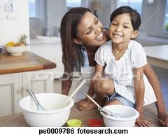
CASE STUDY
Four year old Libby woke up from her nap hungry. Her mother had promised that they would make muffins, a favorite snack. So mom read the recipe and helped Libby measure the ingredients and put them in the correct order. Mom even let her stir at appropriate times. She also lined the muffin tin with paper liners and helped pour the batter into them. When the muffins finished baking and came out of the oven, Libby squealed with delight saying “I did it…..I made muffins!” She was so proud of herself. Together, mom and Libby, enjoyed muffins with a cold glass of milk, which Libby poured by herself.
Identify the physical, intellectual, emotional, and social areas of development taking place in this scenario….

Slide 9
KEY
Physical: small motor skills with stirring & pouring & lining muffin tins
Intellectual: following directions, sequencing, & measuring
Emotional: joy, pride, increased self-esteem
Social: mom & child spending time together

